Slide 1
Equity in IDEA:
Contents of the Final Rule
Presenters: Ruth Ryder, Michael Gross, Richelle Davis

Slide 2
Agenda
Part I Significant Disproportionality
Part II Equity in IDEA Final Rule Overview
Part III Standard Methodology
Part IV Data Reporting
Part V Questions

Slide 3
Part I
SIGNIFICANT DISPROPORTIONALITY

Slide 4
Racial and Ethnic Disparities
IDEA 618 State-reported data (LEA MOE/CEIS Collection):
Roughly 2-3% of districts identified each year as having significant disproportionality (fewer than 500)
2013-2014 school year:
  75% of identified LEAs were in 8 States
  25 States identified no LEAs with significant disproportionality
  Of States that identified LEAs, 10 only identified in one category of analysis (i.e., either identification, placement, or discipline)
  Only four States and one entity identified LEAs in all three categories of analysis

Slide 5
Racial and Ethnic Disparities
IDEA 618 State-reported data:
Black or African American students are twice as likely to be identified as having an emotional disturbance
Black or African American students are over two times as likely to be identified as having an intellectual disability
Black or African American students are 1.4 times as likely to receive services in separate settings

Slide 6
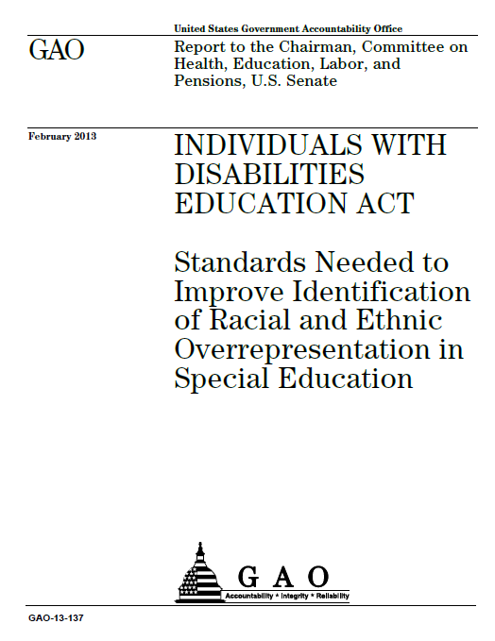
GAO Report: February 2013
Findings:
2% of LEAs in 2010-2011 were identified with significant disproportionality
“the discretion that states have in defining significant disproportionality has resulted in a wide range of definitions that provides no assurance that the problem is being appropriately identified across the nation.”

Slide 7
Notice of Proposed Rulemaking
Notice of Proposed Rulemaking (NPRM) was published on March 2, 2016 and was available for 75 days
Received 316 comments from
  SEAs and LEAs
  Parent
  Advocates
  Researchers
  Associations and organizations
Analyzed comments and prepared the final rule

Slide 8
Part II
EQUITY IN IDEA
FINAL RULE

Slide 9
Final Rule
Final rule package includes
  An Executive Summary (helpful overview)
  Effective Date of these Regulations
  Analysis of Comments and Changes (detailed discussion of comments and our response)
  Regulatory Impact Analysis
  AND the final rule (the last 10-12 pages)

Slide 10
Effective Dates
Final rule is effective 30 days from publication in the Federal Register BUT
States have 18 months to prepare, work with their State Advisory Panel and make decisions regarding their methodology
States must comply by July 1, 2018.

Slide 11
Methodology
Statute requires States to annually collect and examine data to determine whether significant disproportionality based on race or ethnicity is occurring in the State and LEAs of the State with respect to:
Identification of children as children with disabilities, including identification as children with particular impairments
Placement of children in particular educational settings; and
Incidence, duration, and type of disciplinary actions, including suspensions and expulsions

Slide 12
Methodology
Final rule requires States to use a standard methodology to determine if there is significant disproportionality by examining data using a risk ratio or alternate risk ratio analysis.
As part of the standard methodology, States must develop, based on advice from stakeholders (including State Advisory Panels):
a reasonable risk ratio threshold,
a reasonable minimum cell size
a reasonable minimum n-size

Slide 13
Rebuttable Presumption
The final regulations establish a rebuttable presumption that a minimum cell size (numerator or racial/ethnic group being analyzed) of no greater than 10 and a minimum n-size (denominator or comparison group) of no greater than 30 are reasonable

Slide 14
Standard Methodology Flexibilities
States have the flexibility to:
Consecutive Years: Use up to 3 years of data to identify an LEA with significant disproportionality
Reasonable Progress: Not identify LEAs if they are demonstrating reasonable progress in lowering the applicable risk ratios in each of the two prior consecutive years

Slide 15
Review and Revision of
Policies and Procedures
A State is required to:
Provide for the review of policies, practices, and procedures to ensure they comply with the IDEA
LEAs are required to:
Publicly report on revisions consistent with Family Education Rights and Privacy Act (FERPA)

Slide 16
Comprehensive CEIS
LEAs identified with significant disproportionality:
Are allowed to use comprehensive CEIS to serve students, ages 3 through grade 12, with and without disabilities
Are required to identify and address the factors that may contribute to the significant disproportionality

Slide 17
Implementation
OSEP will support implementation of the new requirements set forth by the Equity in IDEA final rule by:
  Providing technical assistance and developing guidance to support States as they prepare to implement the new requirements, see https://www.osepideasthatwork.org/federal-resources-stakeholders/disproportionality-and-equity
  Working with TA Centers such as the IDEA Data Center to support data analysis and implementation

Slide 18
Part III
STANDARD METHODOLOGY

Slide 19
Definitions Made Easy
Risk(risk index): Risk tells us how likely a certain outcome is (i.e. being identified as having a disability)
Comparison group: All other races
Risk ratio: The risk ratio tells us how the risk for one racial/ethnic group compares to the risk for a comparison group
Minimum cell size: Risk numerator
Minimum n-size: Risk denominator
Alternate risk ratio: Uses the district level risk for racial/ethnic group in the numerator and the state level risk for the comparison group. Used if the comparison group does not meet the minimum cell or n-size

Slide 20
Standard Methodology
RISK
A proportion expressing likelihood.
Example:
40 Hispanic children identified
200 total Hispanic children in LEA
Risk of Hispanic child identified as child with disability = 40/200 or 20%.

Slide 21
Standard Methodology
RISK RATIO
A comparison of risks: likelihood of outcome for one group vs. outcome for all others in the LEA
Example:
40 Hispanic children identified out of
200 total Hispanic children in LEA
200 of other children identified out of
All 2,000 other children in LEA
Risk ratio: 2.0
(40/200) / (200/2000) = 0.2 / 0.1 = 2.0

Slide 22
Standard Methodology
RISK RATIO
2.0 = 2x as likely
3.0 = 3x as likely
Etc.

Slide 23
Standard Methodology
RISK RATIO THRESHOLD
What is that significant disproportionality?
A risk ratio > the risk ratio threshold
= significant disproportionality
State must set risk ratio threshold in consultation with stakeholders, including SAP.

Slide 24
Standard Methodology
RISK RATIO THRESHOLD
How many? 14
One for each category of analysis
May set different threshold for each, as reasonable.

Slide 25
Standard Methodology
CATEGORIES OF ANALYSIS:
The identification of children ages 3 through 21 as children with disabilities;
The identification of children ages 3 through 21 as children with the following impairments:
Intellectual disabilities;
Specific learning disabilities;
Emotional disturbance;
Speech or language impairments;
Other health impairments; and
Autism.
Placements of children with disabilities ages 6 through 21, inside a regular class less than 40 percent of the day;
Placements of children with disabilities ages 6 through 21, inside separate schools and residential facilities, not including homebound or hospital settings, correctional facilities, or private schools;
For children with disabilities ages 3 through 21, out-of-school suspensions and expulsions of 10 days or fewer;
For children with disabilities ages 3 through 21, out-of-school suspensions and expulsions of more than 10 days;
For children with disabilities ages 3 through 21, in-school suspensions of 10 days or fewer;
For children with disabilities ages 3 through 21, in-school suspensions of more than 10 days; and
For children with disabilities ages 3 through 21, disciplinary removals in total, including in-school and out-of-school suspensions, expulsions, removals by school personnel to an interim alternative education setting, and removals by a hearing officer.
(34 C.F.R. §300.647(b)(3) and (4).)

Slide 26
Standard Methodology
Categories of Analysis are applied to each of 7 racial or ethnic groups:
Hispanic/Latino of any race, and for individuals who are non-Hispanic/Latino only;
American Indian or Alaska Native;
Asian;
Black or African American;
Native Hawaiian or Other Pacific Islander;
White; and
Two or more races.
(34 C.F.R. §300.647(b)(2).)

Slide 27
Standard Methodology
“SETTINGS” IN STANDARD METHODOLOGY
State must set (in consultation with SAP etc.)
Risk Ratio Threshold and what else?
Reasonable minimum cell size
Reasonable minimum n-size
Period of SD determination (Up to 3 years, optional)
Definition of Reasonable Progress (Optional)

Slide 28
Standard Methodology
CELL SIZES AND N-SIZES
Example:
40 Hispanic children identified out of [cell size]
200 total Hispanic children in LEA [n-size]
200 of other children identified out of [cell size]
All 2,000 other children in LEA [n-size]
Risk ratio: 2.0
(40/200) / (200/2000) = 0.2 / 0.1 = 2.0

Slide 29
Standard Methodology
WHY MINIMUM CELL SIZES AND N-SIZES?
Risk ratios can produce unreliable or volatile numbers when applied to small populations.
Determinations of significant disproportionality should not turn on small demographic changes.

Slide 30
Standard Methodology
WHY MINIMUM CELL SIZES AND N-SIZES?
Example :
In a small LEA, the ratio threshold for Native students identified as CWD = 3.0
4 Native children identified out of [cell size]
8 total Native children in LEA [n-size]
10 children identified out of [cell size]
All 50 other children in LEA [n-size]
Risk ratio: (4/8) / (10/50) = 0.5 / 0.2 = 2.5

Slide 31
Standard Methodology
WHY MINIMUM CELL SIZES AND N-SIZES?
Example cont’d:
Next year, 2 Native students with disabilities moved into the LEA:
6 Native children identified out of [cell size]
10 total Native children in LEA [n-size]
10 children identified out of [cell size]
All 50 other children in LEA [n-size]
Risk ratio: (6/10) / (10/50) = 0.6 / 0.2 = 3.0 the SD threshold

Slide 32
Standard Methodology
MINIMUM CELL SIZES AND N-SIZES
Must be reasonable.
Minimum cell sizes <= 10
Minimum n-sizes <= 30
Are presumptively reasonable

Slide 33
Standard Methodology
ALTERNATE RISK RATIO
A comparison of risks: likelihood of outcome for one group vs. outcome for all others in the State
Because sometimes the comparison group won’t meet the minimum cell or n-size.

Slide 34
Standard Methodology
ALTERNATE RISK RATIO
Example:
Minimum cell size = 5
Minimum n-size = 30
490 out of 500 students in the LEA are Native American / Alaska Native
Number of other students in comparison group = 10, so:
70 Native American / Alaska Native children identified as CWD out of
490 total NA / AN children in the LEA
520,000 children identified as CWD out of
3,640,000 all other children in the State
Alternate risk ratio: (70 / 490) / (520,000 / 3,640,000) = 1.43 / 1.43 = 1.0

Slide 35
Standard Methodology
“CONSECUTIVE YEARS” FLEXIBILTY
or USE “MULTIPLE YEARS OF DATA”
States may choose to make determinations of significant disproportionality only after multiple years (up to three)
Because risk ratios can be volatile and because systematic change can take time.

Slide 36
Standard Methodology
“CONSECUTIVE YEARS” FLEXIBILTY
or USE “MULTIPLE YEARS OF DATA”
Example:
In school year 2019-2020, a State has set a risk ratio threshold for identification of 3.0 and requires an LEA to exceed the threshold for three consecutive years:
Only LEA 2 will be determined to have significant disproportionality in identification, despite the risk ratio of 3.3 for LEA 1 in 2016-17.
 | 2015-16 | 2016-17 | 2017-18
LEA 1 | 2.7 | 3.3 | 2.6
LEA 2 | 3.1 | 3.3 | 3.3

Slide 37
Standard Methodology
“REASONABLE PROGRESS” FLEXIBILITY
Optional
If LEA above risk ratio threshold but lowering risk ratio for the two prior consecutive years, State need not find significant disproportionality.
Specific details of how much risk ratio must be lowered is determined by State in consultation with stakeholders, including SAP.
Given the time it takes to make systematic change, why interrupt something that is working.

Slide 38
Standard Methodology
“REASONABLE PROGRESS” FLEXIBILITY
Example:
State has set a risk ratio threshold for identification.
State has defined “reasonable progress” to mean a year-to-year decline in risk ratio of 0.5.
In school year 2021-2022, the State need not find significant disproportionality for identification in LEA 1.
 | 2018-19 | 2019-20 | 2020-21
LEA 1 | 4.9 | 4.3 | 3.6
LEA 2 | 4.9 | 3.6 | 4.3

Slide 39
Part IV
DATA REPORTING

Slide 40
Data Collection and Reporting
OSEP is still working through the full implications of data collection
  SEAs already provide the majority of the necessary data/information to ED
It is anticipated that the MOE/CEIS collection will have some edits in the coming years
An additional collection vehicle is being discussed to capture the required collection pieces addressed in the Final Rule

Slide 41
File Specifications Used
We anticipate SEAs and LEAs will use counts from these already collected EDFacts file specifications to calculate risk ratios:
File | Description
C002 | Children with Disabilities (IDEA) School Age
C089 | Children with Disabilities (IDEA) Early Childhood
C006 | Children with Disabilities (IDEA) Suspensions/Expulsions
C143 | Children with Disabilities (IDEA) Total Disciplinary Removals
C052 | Membership

Slide 42
How the files are used
 | Identification | Educational environments | Suspension/ expulsion | Total disciplinary removals
Risk numerator / cell size | C002 | C002 | C006 | C143
Risk denominator / n-size | C052 | C002 | C002 C089 | C002 C089
Note: OSEP will provide further clarification around the appropriate risk denominator for 3-5 year olds in the coming months

Slide 43
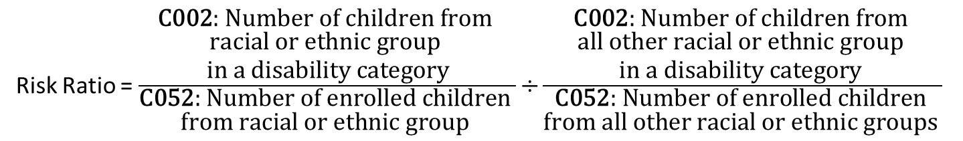
File Specification Example
Risk Numerator
Must have minimum cell size of 10
Risk Ratio = $\frac{\begin{aligned}\text{C}\text{002}\text{: }\text{Number} \text{of} \text{children} \text{from} \\ \text{racial} \text{or} \text{ethnic} \text{group} \\ \text{in} \text{a} \text{disability} \text{category}\end{aligned}}{\begin{aligned}\text{C}\text{052}\text{: }\text{Number} \text{of} \text{enrolled} \text{children} \\ \text{from} \text{racial} \text{or} \text{ethnic} \text{group} \end{aligned}}\text{÷}\frac{\begin{aligned}\text{C}\text{002}\text{: }\text{Number} \text{of} \text{children} \text{from} \\ \text{all} \text{other} \text{racial} \text{or} \text{ethnic} \text{group} \\ \text{in} \text{a} \text{disability} \text{category} \end{aligned}}{\begin{aligned}\text{C}\text{052}\text{: }\text{Number} \text{of} \text{enrolled} \text{children} \\ \text{from} \text{all} \text{other} \text{racial} \text{or} \text{ethnic} \text{groups} \end{aligned}}$
Risk Denominator
Must have minimum N- size of 30

Slide 44
SSS-IDEA User Guide Updated
SSS-IDEA User Guide has been updated to identify the requested pieces of a State’s definition of significant disproportionality
The definition should include the following elements, as appropriate:
The calculation method(s) being used (i.e. risk ratio, weighted risk ratio, eformula, etc.);
Any minimum cell- or n-sizes (i.e. risk numerator and/or risk denominator);
The number of years of data used in the calculation; and
The threshold at which significant disproportionality is identified.

Slide 45
Data Quality Plug
Data quality is increasingly important, especially at LEA and school level
  More and more of the 618 data is being used for high stakes decisions
Building in more sophisticated edit checks
  Increases the role of strong meta-data and meta-data to collected data checks
State data quality has been improving over the past several years
  Use lessons learned at SEA-level to continue improving LEA and school data

Slide 46
Part V
QUESTIONS
Please send questions for us to address in future guidance at significantdisproportionalityrule@ed.gov

