Slide 1
Grantee Guide to Project Performance Measurement
November 2018
Victoria Schaefer
Shauna Harps
Center to Improve Program and Project Performance (CIPP)
The contents of this presentation were developed under contract ED-ESE-15-A-0016/0004 from the Department of Education. However, those contents do not necessarily represent the policy of the Department of Education, and you should not assume endorsement by the Federal Government.” (Authority: 20 U.S.C. 1221e-3 and 3474).

Slide 2
Today’s Session
Provide an overview of the Grantee Guide to Project-Performance Measurement (Guide).
Provide a brief presentation of key concepts.
Describe and demonstrate functionality of tools that support project measure development.

Slide 3
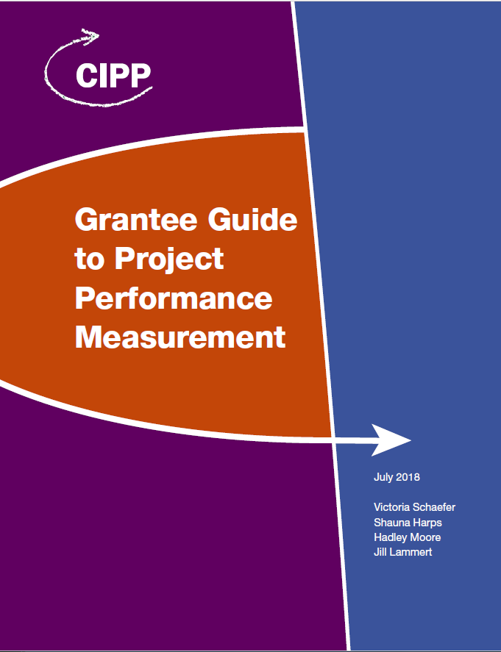
Big Picture: Information to be Covered
Start broad, identifying ideal measures
Ultimately narrow the list to what is feasible for the project
Potential Measures

Slide 4
Types of Performance Measures
Two Types of Performance Measures
GPRA: Measures established for reporting to Congress under the Government Performance and Results Act (GPRA).
At OSEP, these are often called “Program” measures.
Project: Project-specific performance measures, which are included in each approved grant application. They can be aligned to GPRA measures.
The Guide and today’s session focus on project measures.

Slide 5
A Portfolio of Measures

Slide 6
Setting the Stage for Success
Create a performance measurement team.
Identify team members with substantive knowledge of the project to serve in critical roles.
Establish a meeting schedule.
Identify suggested ground rules for the work.

Slide 7
Learning Check
What is your level of familiarity with project performance measurement?
1. Unfamiliar
2. Somewhat familiar
3. Familiar
4. Very familiar

Slide 8
5-Step Process for Measure Development

Slide 9
Step 1: Build Foundational Knowledge – 1 of 3
Take time to review all relevant documentation to ensure a strong foundation for measure development.
Ensure all team members hold a shared understanding of the background materials supporting the work.

Slide 10
Step 1: Build Foundational Knowledge – 2 of 3
Documentation to review includes, but may not be limited to:
OSEP documentation related to the grant.
Relevant grant project documentation, such as:
grant application
project logic model and theory of change
project goals
research studies or other literature related to the project or its outcomes
project plan
evaluation plan
cooperative agreement

Slide 11
Step 1: Build Foundational Knowledge – 3 of 3
Key questions:
What is the purpose of your project?
What do you hope to achieve?
What is the evidence base for your project?
Who will achieve the change?
How much change is expected?
When will the change take place?

Slide 12
Step 1 Template: Summary of Key Points from Document Review

Slide 13
Learning Check
What types of documents and materials will help you build foundational knowledge, as suggested in Step 1?
List of Office of Special Education Programs (OSEP) programs
Project plan, grant application, and guiding literature
The U.S. Department of Education’s Strategic Plan

Slide 14
Learning Check
Where might you look to identify key project activities, outputs and outcomes?
Project logic model
OSEP program guidance
U.S. Department of Education Strategic Plan
All of the above
None of the above

Slide 15
Step 2: Identify Key Project Activities, Outputs, and Outcomes
The logic model is a good source of information.
Engage in a brainstorming session to help generate ideas.
The Step 2 Template is available to record your ideas.

Slide 16
Step 2 Template: Key Project Activities, Outputs, and Outcomes

Slide 17
Step 2 Template Demonstration
What are the key activities?
What are the key outputs?
What are the key short-term outcomes?
What are the key medium-term outcomes?
What are the key long-term outcomes?

Slide 18
Step 3: Identify the most critical indicators of progress and results
Narrow the list (from Step 2) to include only the most critical and meaningful project indicators.
The Guide includes tools to help grantees prioritize the activities, outputs, and outcomes (Step 3 Template A and Template B).
Consider having team members complete the prioritization independently first, then review scores together.

Slide 19
Step 3 Template A: Assessment of Key Project Activities, Outputs, and Outcomes
Use the Step 3 Template A to:
Enter scores for each key item
Identify the highest-scoring items
Use the Step 3 Template B to:
List the highest-scoring items before moving to Step 4

Slide 20
Step 3 Template A: Assessment of Key Project Activities, Outputs, and Outcomes

Slide 21
Step 3 Template B: Key Items to Use as Potential Project Measures
Enter the highest-scoring indicators from the Step 3 Template A in the Step 3 Template B handout.

Slide 22
Step 3 Template B: Key Items to Use as Potential Project Measures

Slide 23
Learning Check
What should you do to prioritize your list of items?
Assess all the items identified in Step 2.
Identify score threshold for items to advance to Step 4.
A and B.
None of the above.

Slide 24
Step 4: Select Logic Model Items
Select the final set of items for project performance reporting.
Consider:
The number of key items identified in Step 3 Template B.
Key project milestones or accomplishments that indicate progress toward achieving outcomes.
Costs and feasibility of measuring the items.
Avoid “over-measurement.”
The project team should work together to reach agreement on the final list of items.

Slide 25
Step 4 Template: Final List of Items for Use as Project Performance Measures

Slide 26
Learning Check
What do you think is the most important consideration for creating the final list of project performance measures?
Project triumphs to signify steps toward achieving outcomes.
Costs and feasibility of measuring the items.
Other (please share your thoughts).

Slide 27
Step 5: Finalize Performance Measure Language
Create measures that specify:
“What” is being measured.
“Who (or what)” will achieve the change.
“How much” change is expected.
“When” the change will take place.
Finalize the language for project performance measures.
Outline important details about expected changes.
Use action-oriented terms (e.g., increase, decrease).
Notes:
Note from Kristen: at the osep meeting, we had a long discussion about whether "who" was the right word or emcompassed systems. make sure to mention that systems are part of the who

Slide 28
Step 5 Template: Final Project Performance Measure Language
Type | Initial Item Text | *What? | *Who? | *How Much? | *When? | Final Project Measure Text

Slide 29
Step 5 Template: Final Project Performance Measure Language
Type | Initial Item Text | *What? | *Who? | *How Much? | *When? | Final Project Measure Text
Short-term outcome | Increased knowledge of best practices for students with disabilities in elementary reading instruction among general and special educators | Knowledge of best practices | General and special educators in participating LEAs | 25-point increase | At the beginning of each school year and at the end of the school year | ?
How do you combine the information in these columns to write a refined, clearly specified measure?
What should the final project measure text be for the sample item above?

Slide 30
Final Project Measure Text for Sample Item
Type | Initial Item Text | *What? | Who? | How Much? | When? | Final Project Measure Text
Short-term outcome | Increased knowledge of best practices for students with disabilities in elementary reading instruction among general and special educators | Knowledge of best practices | General and special educators in participating LEAs | 25-point increase | At the beginning of each school year and at the end of the school year | Percentage of general and special educators in participating LEAs who complete the annual Reading Instruction Best Practices Workshop and increase their knowledge related to best practices for students with disabilities in elementary reading instruction by 25 points as measured on a knowledge assessment at the beginning and end of each school year, between grant years 1 and 5

Slide 31
Reminders
Work with your Project Officer to revise your measures.
Work with your evaluator to collect, analyze, and report relevant information.
Visit OSEP’s IDEAs That Work website (https://osepideasthatwork.org/) for the Grantee Guide to Project Performance Measurement and other relevant tools and resources!

Slide 32
Questions and Discussion
What questions do you have for us?
Questions for you:
What do you think will be the most challenging part of this process?
How can you apply what you’ve learned today to improve the quality of your project’s performance measures?

Slide 33
Questions for CIPP?
Email: CIPP@westat.com
Phone: 1-888-843-4101
SharePoint: www.cippsite.org

