Slide 1
High Expectations and Appropriate Supports: The Importance of IEPs

Slide 2
Today we will focus on:
Factors that drive high expectations, such as child, family and other stakeholder engagement, and the support children and families need to meet those expectations;
Supporting States to ensure that each child has access to an education that best meets her or his unique and individual needs;
How high expectations relate to State academic content standards; and
How we can support States/LEAs to incorporate evidence-based practices in the IEP.

Slide 3
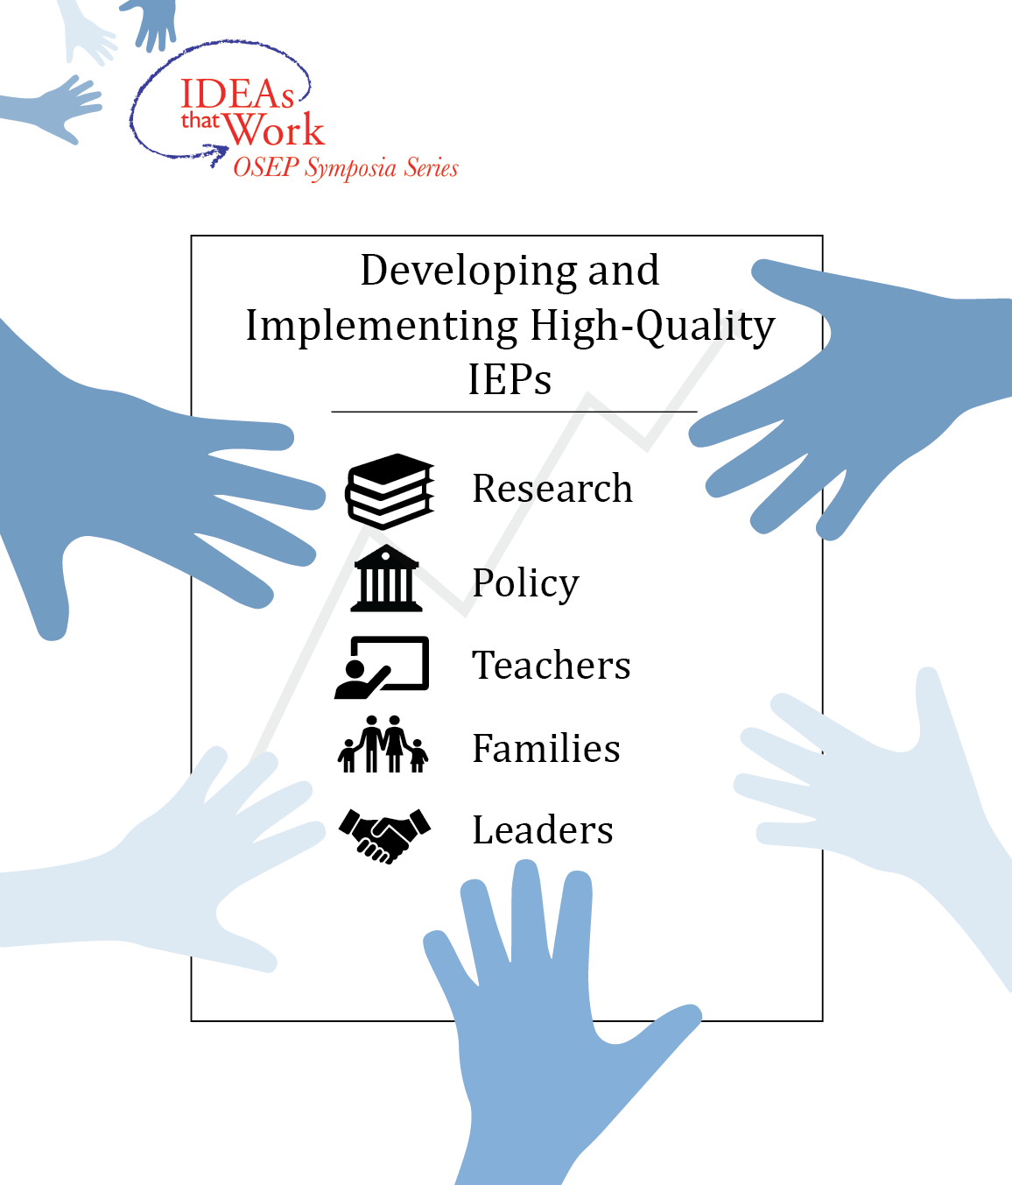
Slide 3

Slide 4
Slide 4

Slide 5
High Expectations and Individualized Supports to Meet the Endrew F. Standard

Slide 6

Board of Education v. Rowley, 1982
458 U.S. 176 (1982)
Notes:
The first special education case heard by the U.S. Supreme Court
Amy Rowley, had a severe hearing impairment-The dispute involved the service of a qualified sign language interpreter
District court & Court of Appeals-District failed to provide Amy a FAPE because the school district did not offer her an opportunity to achieve to her full potential at a level commensurate with the opportunity provided to children without disabilities

Slide 7
The Rowley Two-Part Test
Has the state complied with the procedures set forth in the law?
Is the resulting IEP reasonably calculated to enable the student to receive educational benefit?
Notes:
The Court applied the two-part to the case of Amy
The school district had complied with the procedures of the law , thus meeting part 1 of the test
Also, the court held that Amy had received educational benefit because she was passing from grade to grade, thus meeting part 2 of the test benefit-Footnote
Herein lay the problem-Amy had a IQ of 125 and was academically very able-The Supreme Court was essentially able to sidestep the 2nd part of the test
When applying the FAPE test to individual cases, courts began to have different interpretations of the 2nd or substantive part of the Rowley test

Slide 8
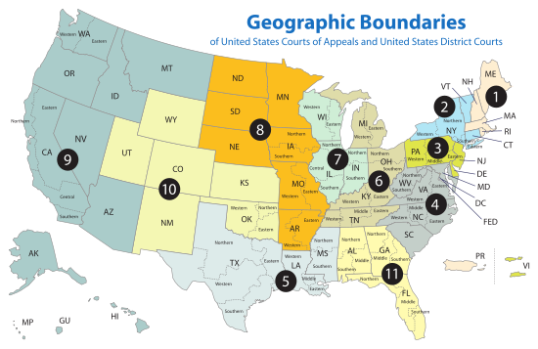
FAPE Tests
Lower
Standard
Lower
Standard
Confused!
Standard
Lower
Standard
Lower
Standard
Higher
Standard
Lower
Standard
Higher
Standard*
Lower
Standard
Notes:
In FAPE case, the U.S. Courts of Appeal for the various Circuits developed different standard to determine whether an student’s education had conferred educational benefit
Higher standard-The Meaningful benefit standard-3rd, 5th, & 6th ” (Quote from Polk)
Lower standard-The de minimis standard2nd, 4th, 7th, 8th, 10th, & 11th
The most recent of these standards was the 10th circuit decision in Endrew v. Douglas County School District
Confused circuit-Some panels going with the de minimis standard and some the meaningful benefit standard

Slide 9
The Tenth Circuit’s Educational Benefit Standard
“The educational benefit mandated by the IDEA must merely be more than de minimis”
Notes:
Now famous quotation from the decisions was that the educational benefit offered Drew had to be “merely more than de minimis”

Slide 10
Appeal to the U.S. Supreme Court
On December 22, 2015 the parents appealed to the U.S. Supreme Court
Question Presented: What is the level of educational benefit school districts must confer on children with disabilities to provide them with the free appropriate public education guaranteed by the Individuals with Disabilities Education Act?
Certiorari Granted on September 29, 2016
Notes:
Would it be the lower de minimis standard of the 10th circuit or would it be the higher meaningful benefit standard of the 6th circuit

Slide 11


Oral Arguments: January 11, 2017

Slide 12

Supreme Court Ruling: March 22, 2017
Supreme Court Ruling: March 22, 2017
“To meet its substantive obligation under the IDEA, a school must offer an IEP reasonably calculated to enable a child to make progress appropriate in light of the child’s circumstances.” (Endrew, 2017, p. 16)
Notes:
Mitch

Slide 13
Supporting Each Child’s Individual Needs

Slide 14
Supporting Each Child’s Individual Needs
Karen Erickson, PhD
Yoder Distinguished Professor, Director Center for Literacy & Disability Studies
University of North Carolina at Chapel Hill

Slide 15
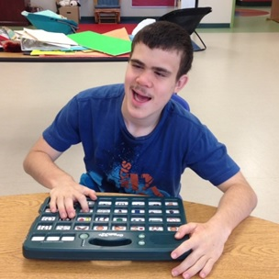
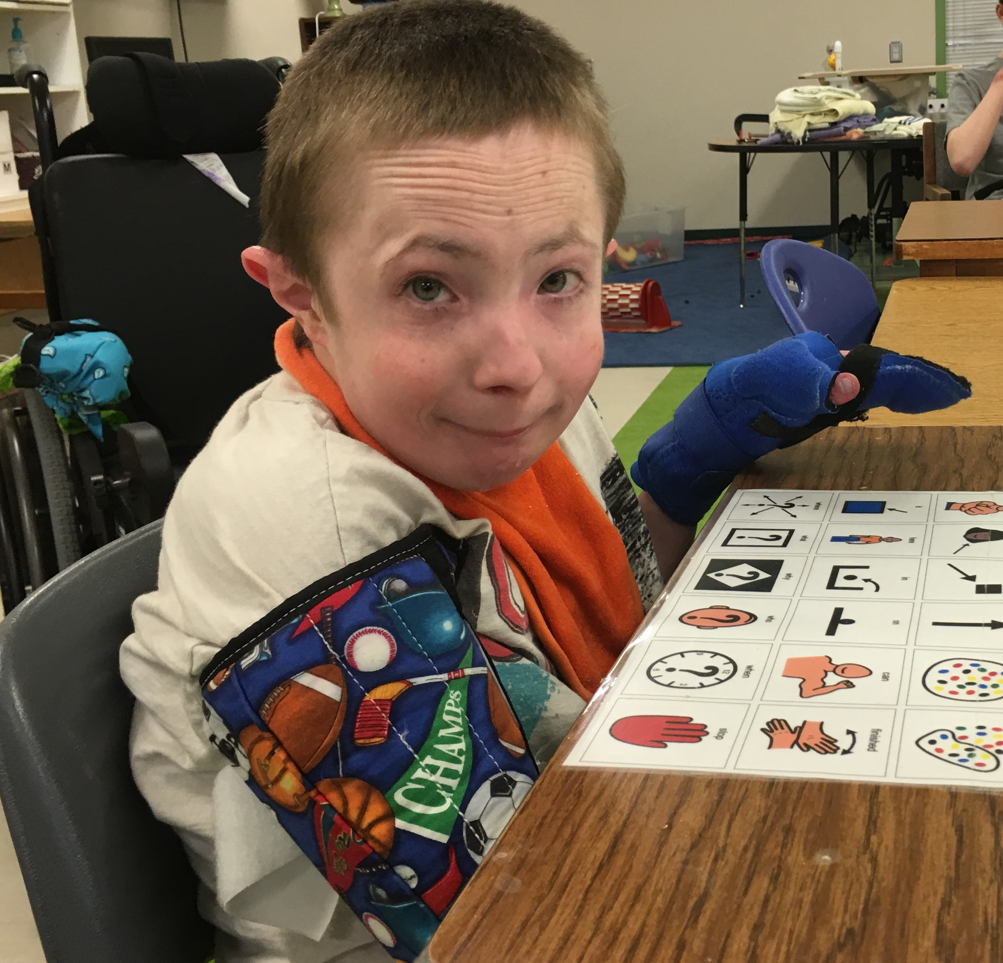
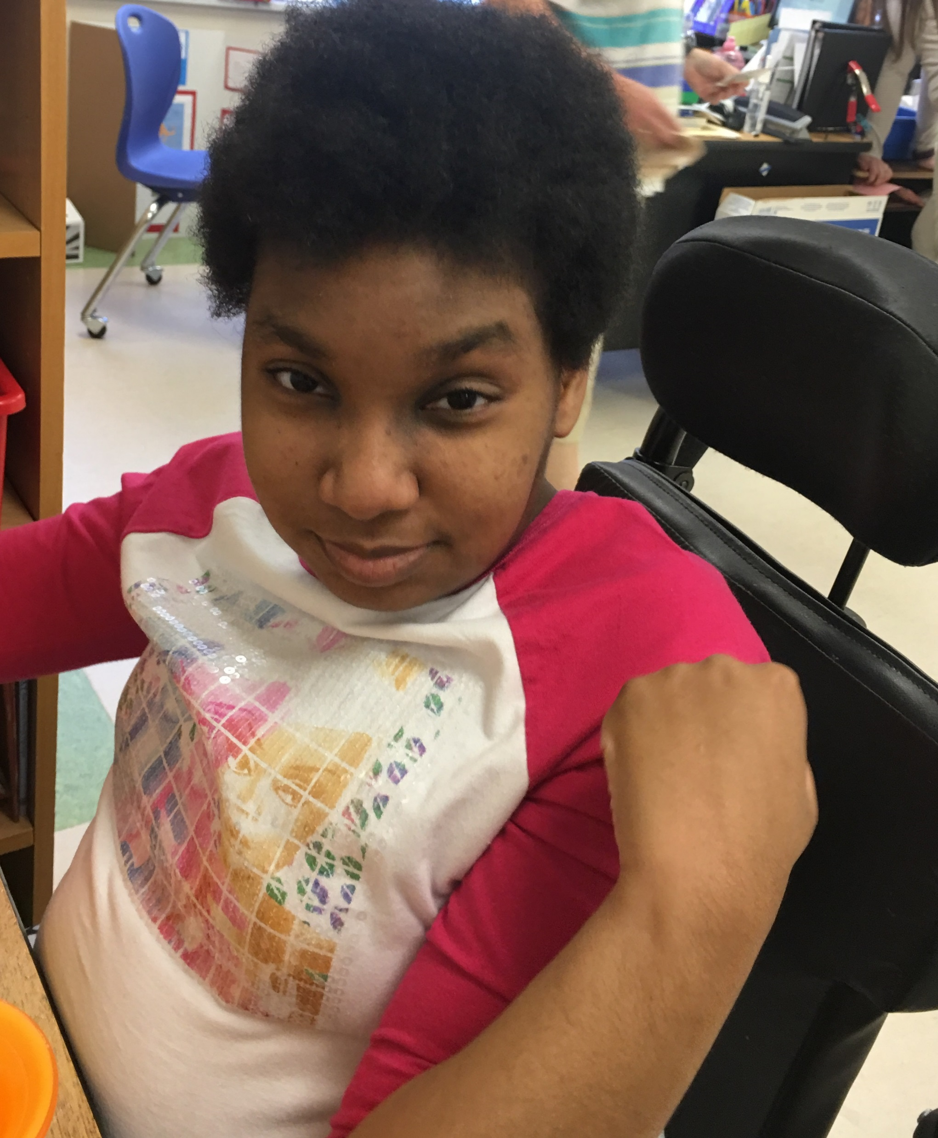
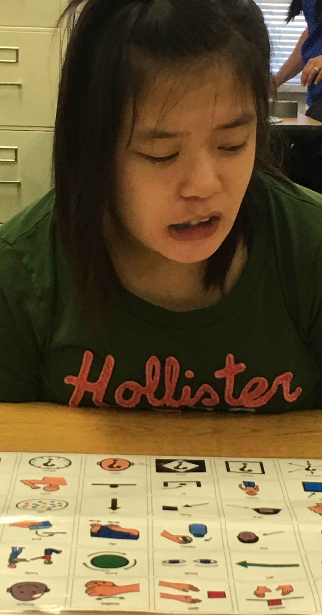
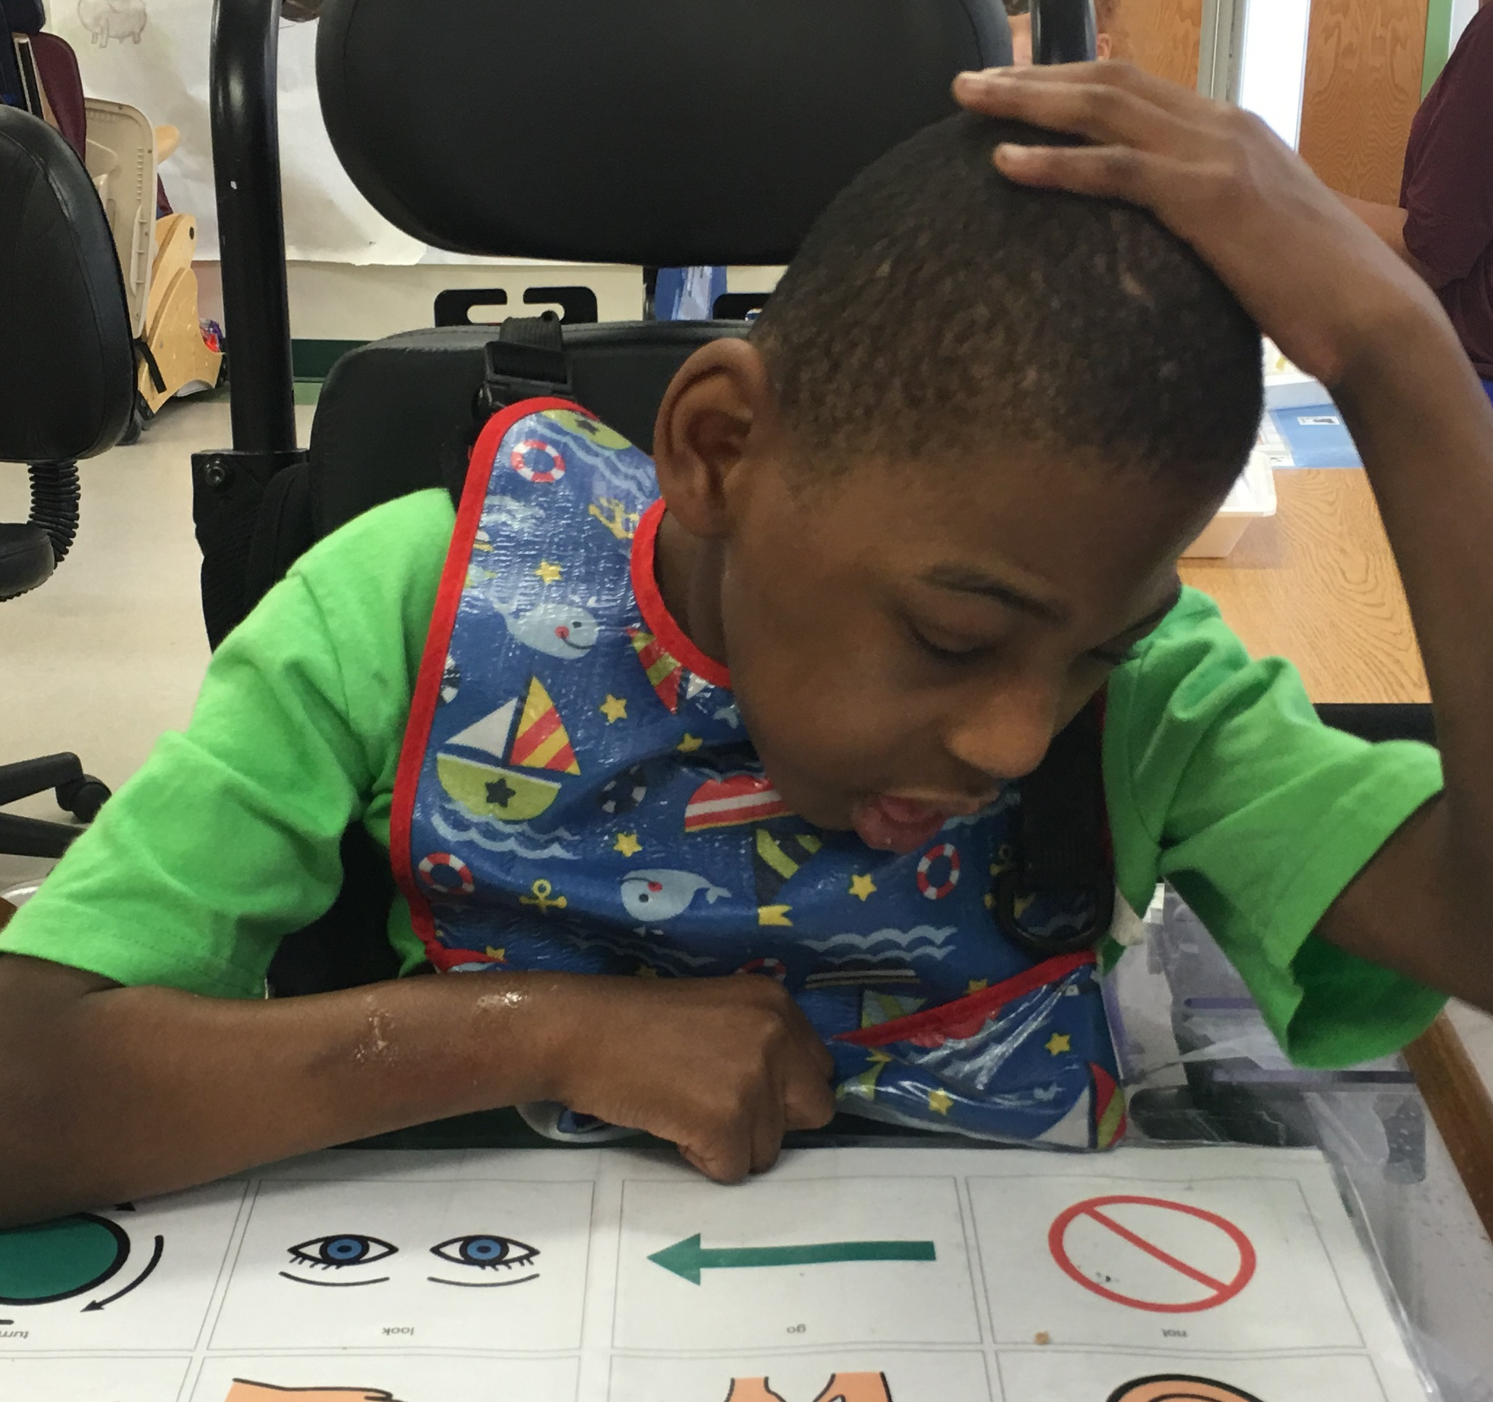
High Expectations for All
Notes:
My work for more than 30 years has focused on improving academic outcomes of students with the most significant cognitive disabilities. As a teacher in the late 1980’s, I was among the first generation of teachers to embrace assistive technology, including augmentative and alternative communication, as a way to more successfully support each child’s needs and help them meet the high expectations we held.

Slide 16
MASTERY
Notes:
But from the beginning of my career, I have pushed back on the notion of mastery as the sole indicator of academic success, not just for the students with complex support needs I have always taught and now study, but for all students. What I noticed from the beginning of my career was that I could apply many different methods to help students achieve mastery, but when that was the goal, my students seemed to miss out on many other important things while we focused on mastery of the skills and behaviors on the IEP.

Slide 17
MASTERY
80% accuracy on 4 of 5 days
Notes:
Today, I still see IEP after IEP that seeks consistency and mastery of skills identified by teams. Usually, that consistency or mastery is reflected in goals and objectives with criteria of 80% on 4 of 5 days or trials or opportunities. I have seen a shift toward academic goals that link to grade level standards, but the goals address skills that are so disconnected from the overall intent of the standards that they have little meaning and do little to help students progress through the grades in a meaningful way.

Slide 18
Universal Design for Learning
Notes:
When I first learned about UDL, I was overjoyed with the idea that it might lead to a change in the way we craft IEPs. The emphasis on multiple and flexible that is the hallmark of UDL left me hopeful that we might move away from narrowly focused IEP goals and objectives that specify the rigid conditions under which a student will demonstrate mastery of a skill. I am certainly not alone in my efforts to push for IEP goals and objectives that are SMART, which isn’t always defined in the same way, but generally refers to goals that are Specific, Measurable, Attainable, Results-oriented and Time-bound, but smart goals do not have to focus on single skills demonstrated to mastery with consistency over time.

Slide 19
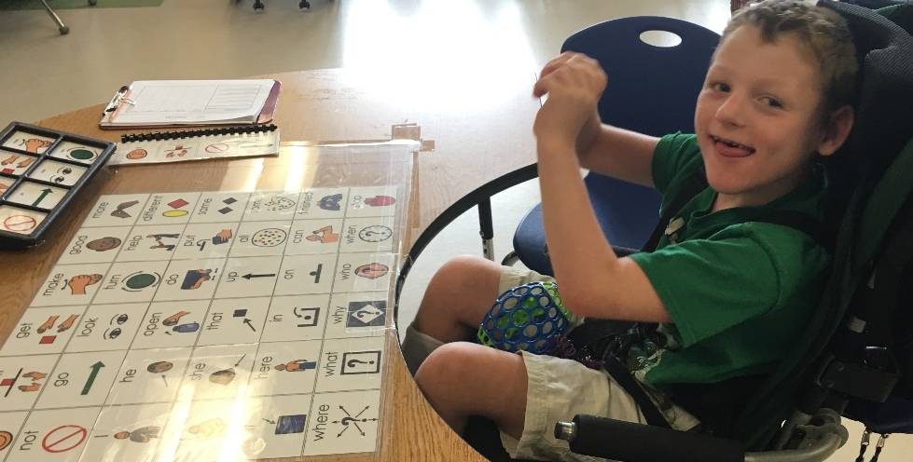
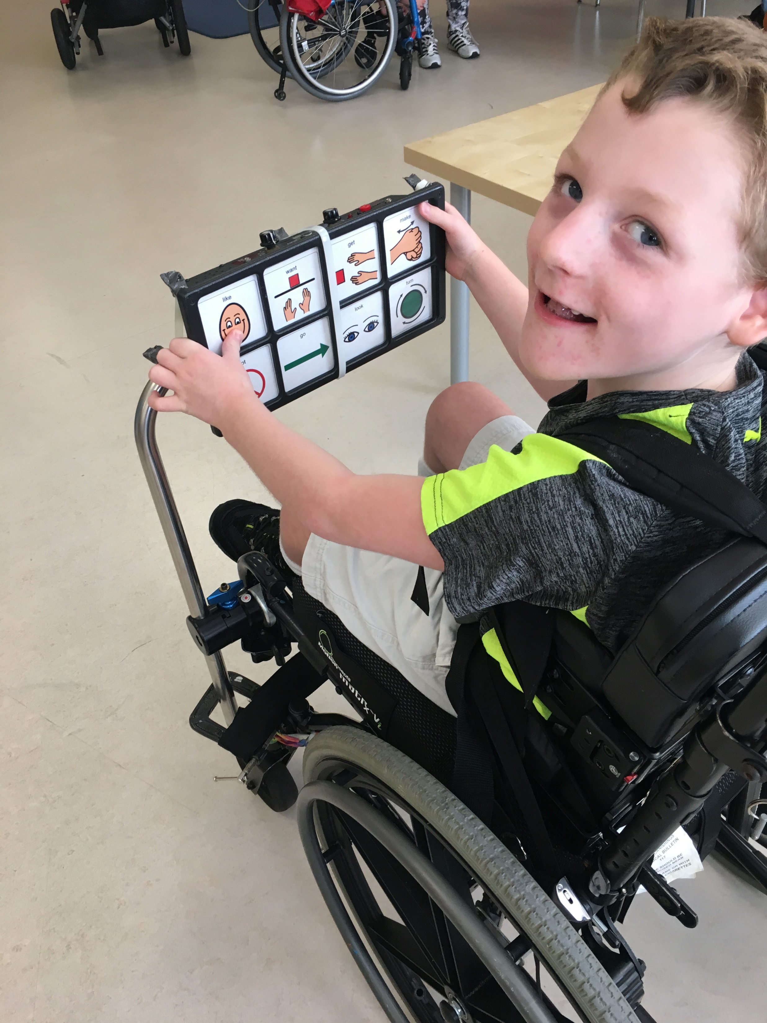
Learning that Builds Over Time
Notes:
Instead, they have to focus on skills that reflect the kinds of pivotal skills that help students learn over time. The current focus of standards across the country, and the findings of Endrew F, reflect an expectation that learning will build over time. Perhaps narrowly focused IEP goals and objectives are one of the factors that keep many students with significant cognitive disabilities from continuing to make academic progress after elementary school. If the standard has been ensuring that goals are so targeted that students are sure to demonstrate some progress, have we been doing our students as disservice? There are too many students like this boy. They are approaching adolescence without being able to use speech, signs, or symbols to communicate with the world. This boy could match symbols to preferred objects and foods. He could identify, “each symbols in a set of 8 picture communication symbols with 75% accuracy on 3 consecutive trials,” but he could not use the symbols to initiate, respond, interact, share information, establish social connections, or communicate for any of the dozens of other communication purposes that are required for success in advancing from one grade to the next. Much to all of our delight, perhaps especially his, there has been a big shift in the focus of his IEP for the past 18 months. Instead of goals that seek mastery of the symbols themselves, his IEP goals now reflect pivotal communication skills like initiating, sharing information, and responding to open-ended questions. Now, he is successfully using a much larger array of symbols to achieve a much broader set of communication purposes and his progress across the curriculum has been exponential.

Slide 20
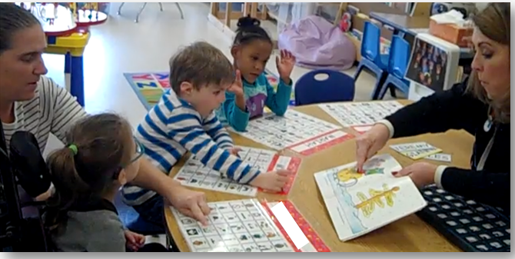

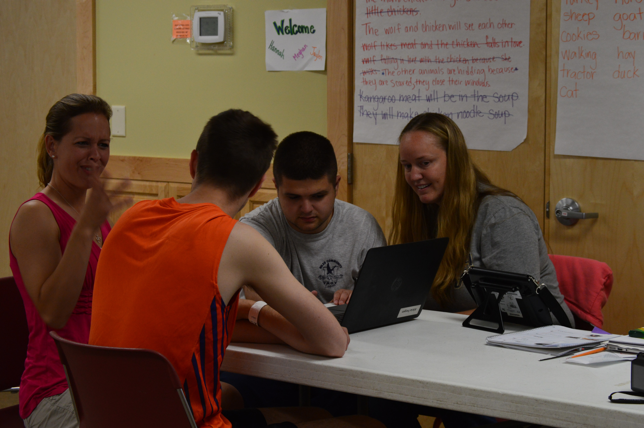
Active Participation and Interaction
Notes:
The ability to participate actively and interact with others in the environment is another pivotal skill that is reflected in current standards across the country. Students are expected to initiate and participate effectively in a range of collaborative discussions about various topics. How does one master the art of initiating and participating? I would argue that none of us are ever masters of these skills, but we can write IEP goals that focus on getting students who can’t initiate to initiate more frequently, and we can write goals that help those who initiate too often learn to focus their initiations on the topic at hand to increase their active participation with the group.

Slide 21
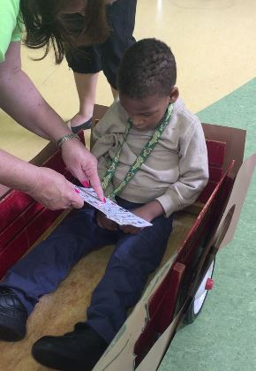
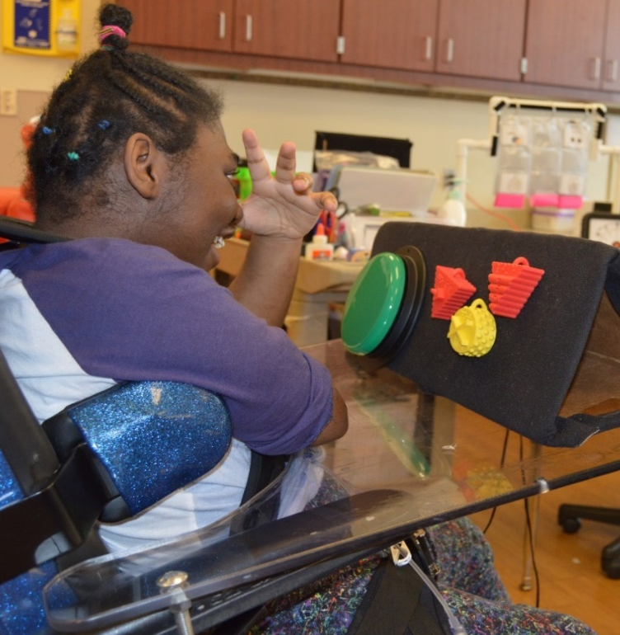

Application of Knowledge and Skills
Notes:
Finally, as we work to create IEPs that support each student’s individual needs while helping them achieve high expectations, we must focus our expectations on the application and use of knowledge and skills. Decades of research suggests that students with significant cognitive disabilities struggle to generalize skills as they learn them, but could they be more successful if our IEPs focused on not on the mastery of skills with 80% accuracy on 4 out of 5 days, but instead focused on the use of those skills in novel contexts for novel purposes? Could we be far less concerned that students demonstrate skills in the context of our carefully crafted trials and instead concern ourselves with looking for the application of those skills where they are needed most? Could we respond to the demands of current standards and Endrew F by addressing anchor standards and pivotal skills instead of focusing on skills that we pluck from the standards themselves? Could we realize the potential of UDL for all students by focusing on building knowledge and teaching skills in the multiple and flexible ways that is required for them to apply what they learn and continue learning over time.

Slide 22
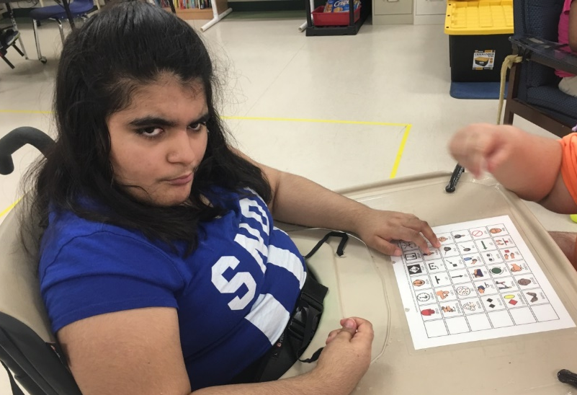
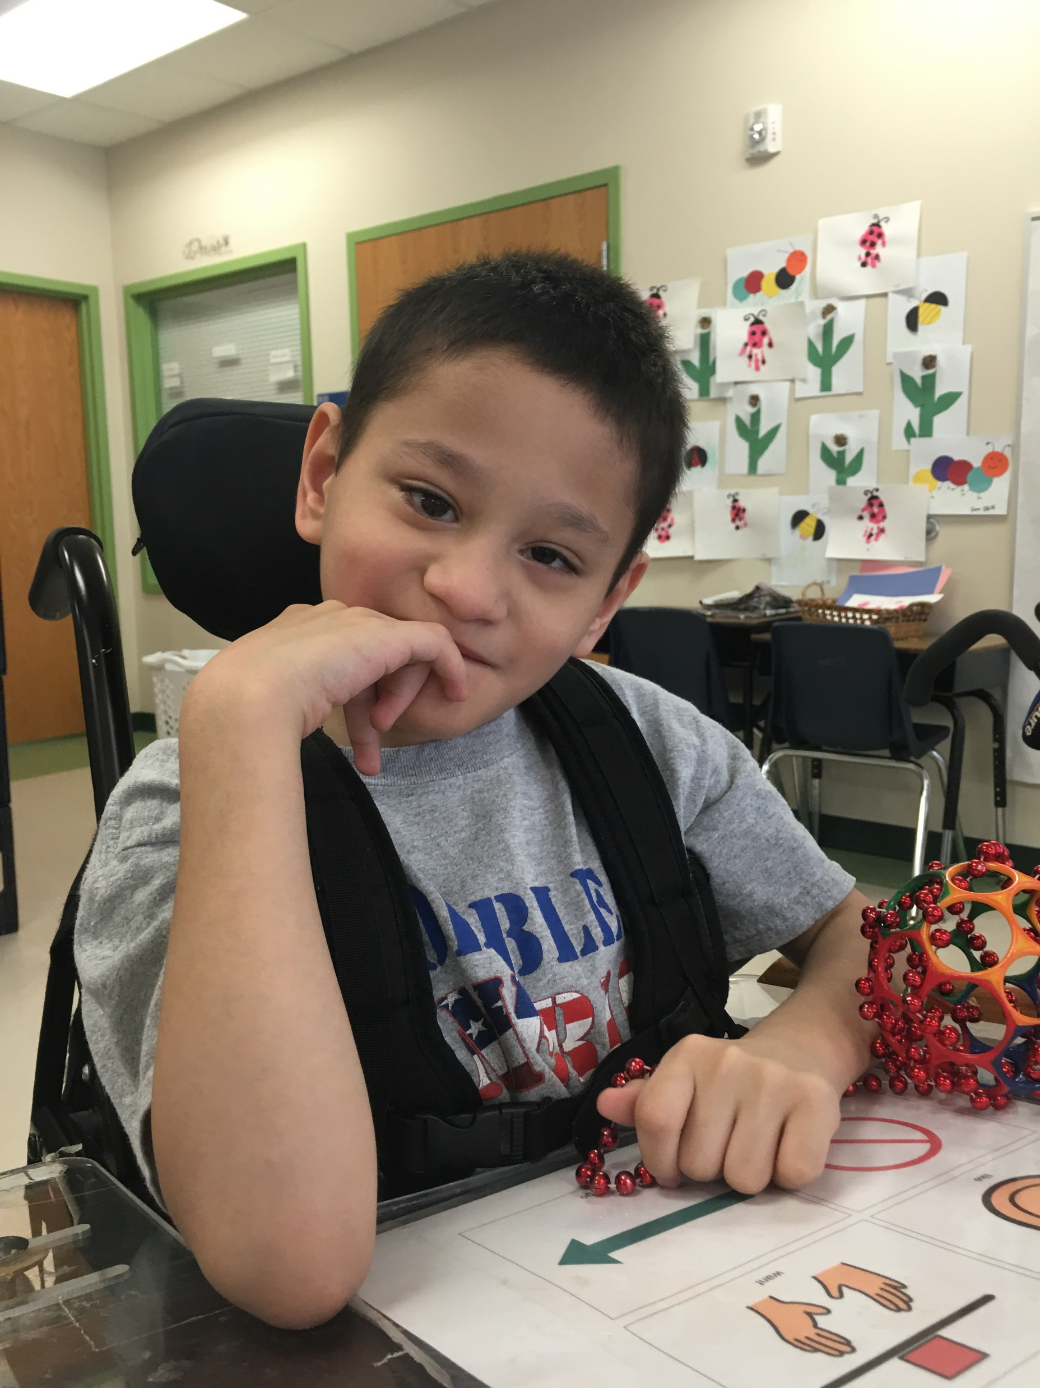

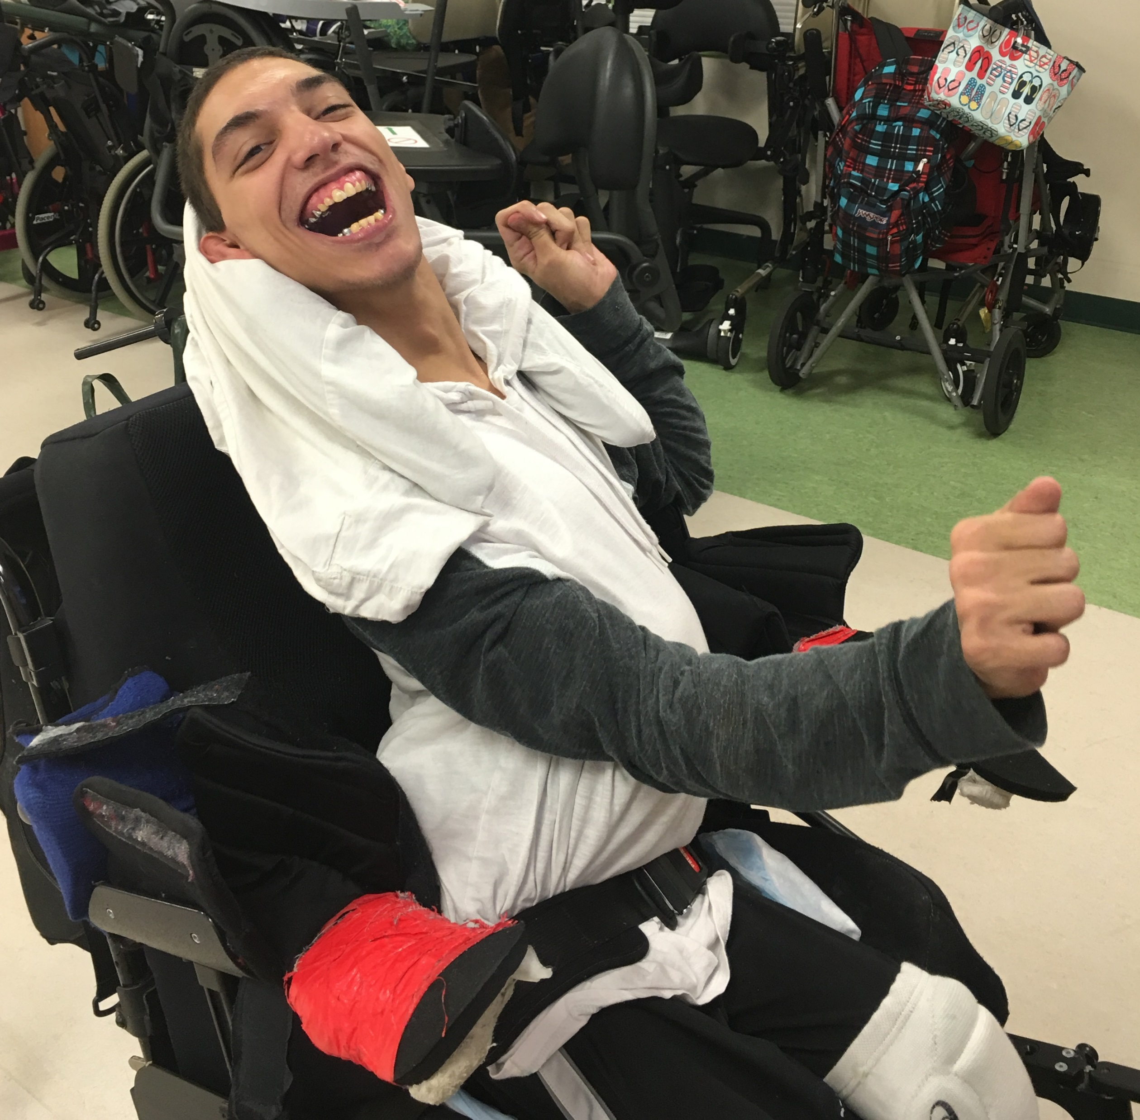

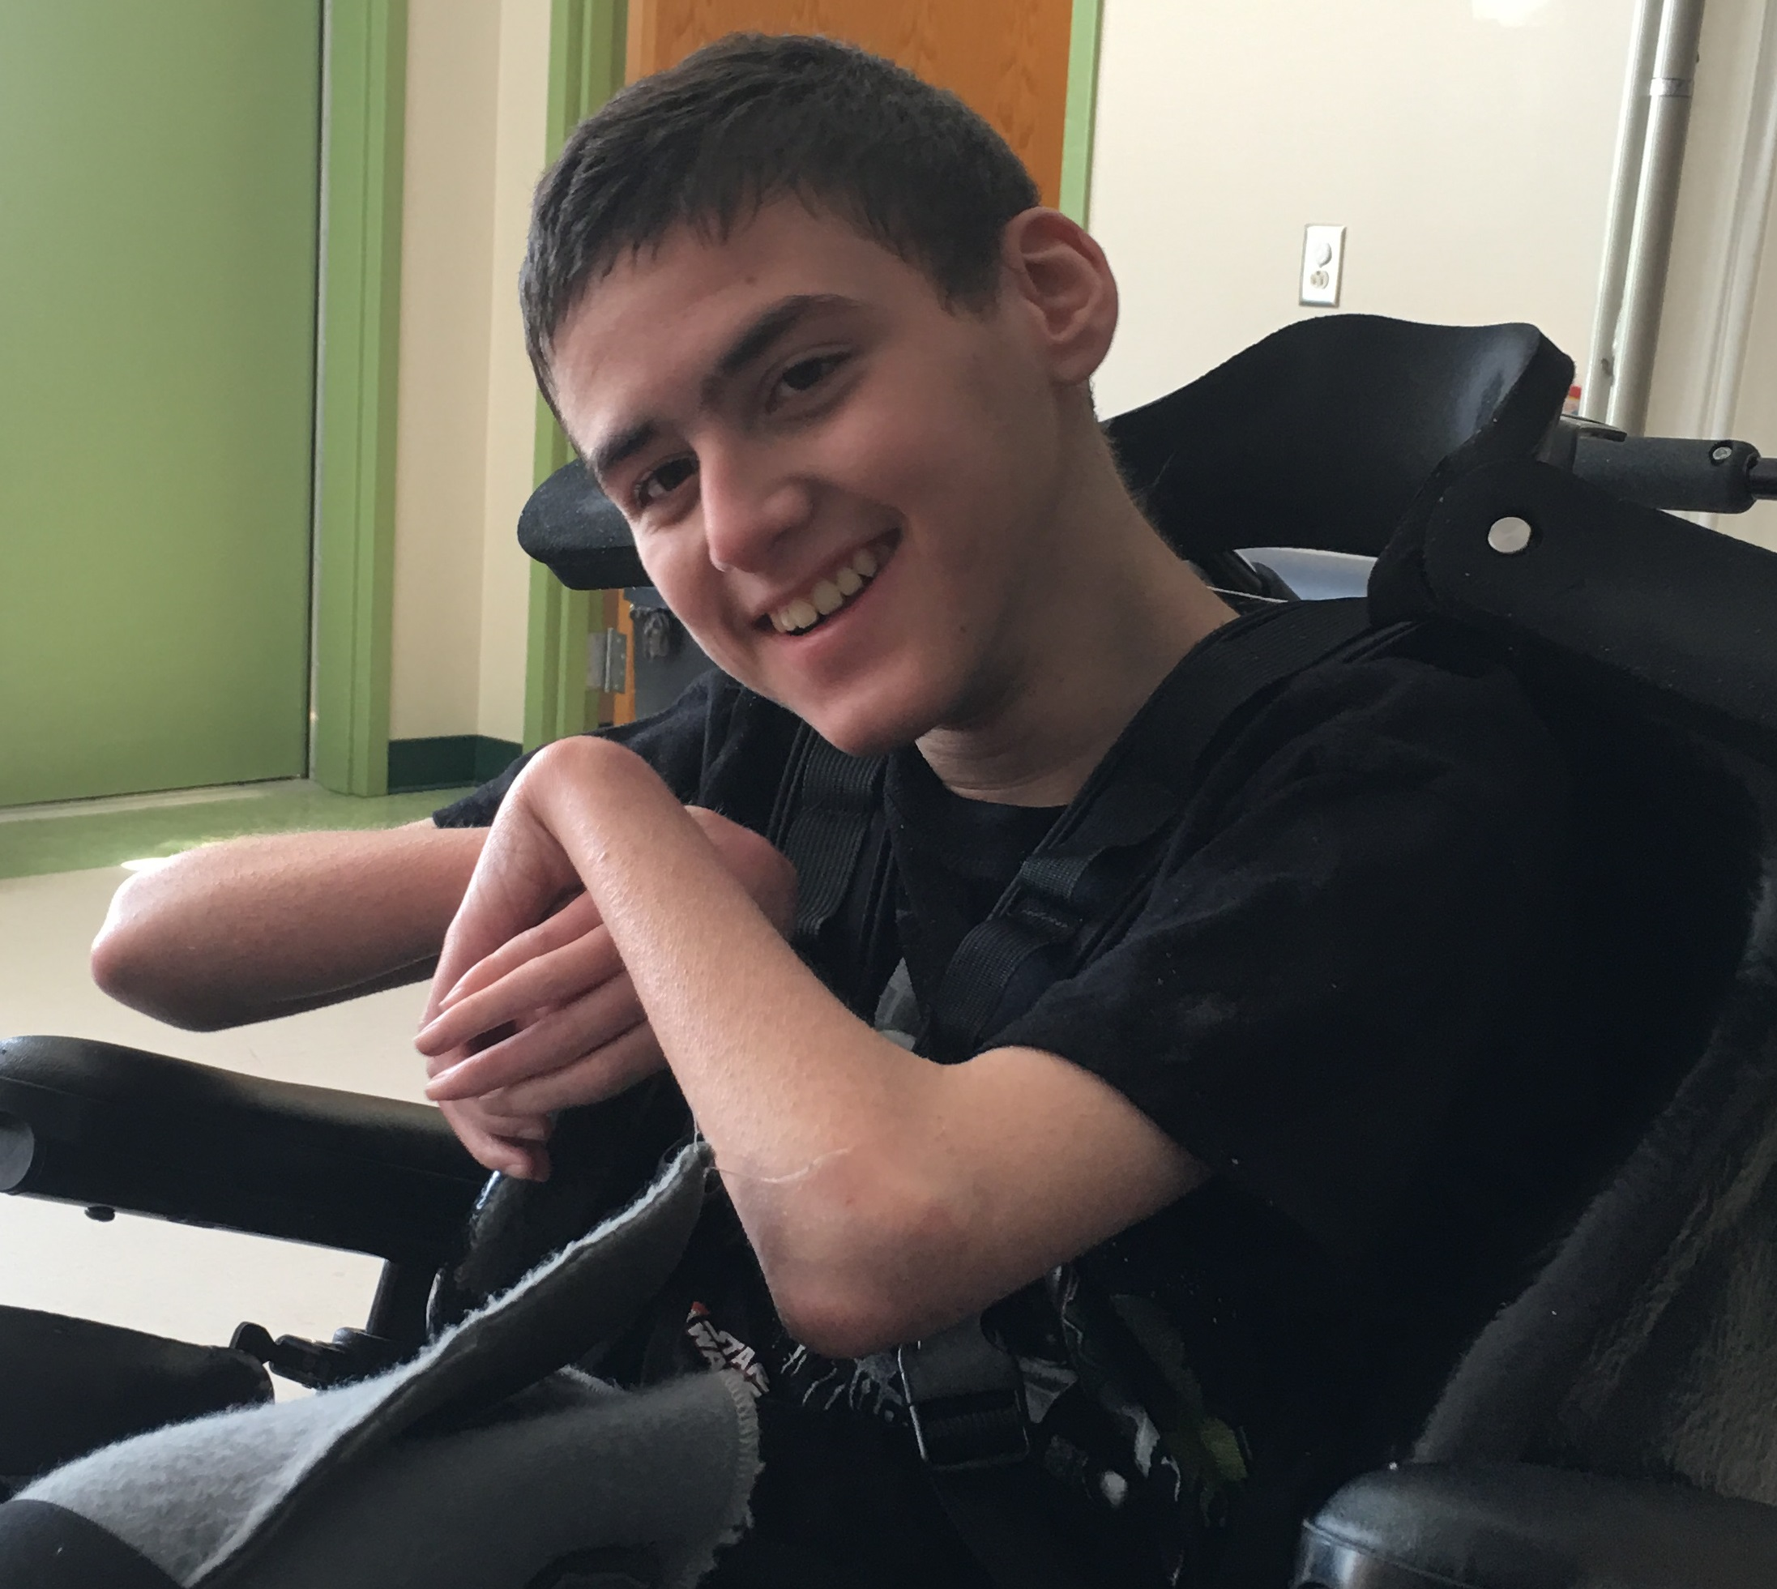
Slide 9
Notes:
These students and hundreds of others have helped me learn that we have no choice but to concern ourselves with creating IEPS that address the application and use of pivotal knowledge and skills that build over time to maximize gains from one grade level to the next.

Slide 23

Slide 10

Slide 24

Supporting Each Child’s Individual Needs
Kelly Henderson, Ph.D.
Formed Families Forward
Fairfax, VA
Notes:
Good afternoon. I am Kelly Henderson, and I have the honor or directing a family-led nonprofit organization in northern Virginia, Formed Families Forward. I am very pleased to be here today and appreciate the opportunity to share a few thoughts on this critical topic.

Slide 25
Community Parent Resource Centers
Since 1977, IDEA has supported some types of parent centers; now have 65 parent training and information centers (PTIs), one or more in each state. In addition, three national parent centers provide TA widely.
Six Regional Parent Technical Assistance Centers support parent centers.
Community Parent Resource Centers initiated in 1997. Today 29 CPRCs focus on specific population/geographic/language groups; often underserved, over-identified students.
Formed Families Forward focuses on the supporting families formed through foster care, adoption and kinship care, raising children and youth with disabilities. FFF has benefited from OSEP support as a CPRC since 2012.
Notes:
First, a little about OSEP-funded parent centers. As we are all aware, parent and family involvement in special education is fundamental to IDEA and its predecessors. The federal law has emphasized parent participation not only through specific provisions regarding eligibility and IEPs, but also through its commitment to parent and family support and technical assistance. Currently, a total of 65 Parent Training and Information Centers serve families in all states and territories. In 1997, Community Parent Resource Centers were born in their current form. CPRCs focus on specific underserved populations, such as those in a smaller geographic area, a community with particular language needs, and so on. We at Formed Families Forward work to support foster, adoptive and kinship families. Kinship care is provided formally or informally by extended family members such as grandparents, when parents are unavailable or unable to care for their children.
Background notes: Experimental PTIs were funded in 1990s= The traditionally underserved, over-identified students
Language, socio-economic, rural/remote; The hard to reach families; These morphed in to Community Parent Resource Centers (CPRCs) in 1997; Programs designed to serve a specific population/geographic/language group

Slide 26
Children & youth in foster, adoptive, kinship care
2% of children are in adoptive homes; over 10% of children are in homes headed by grandparents or other non-parent relatives; 1% of children are in foster care over a year’s time.
Children who are being raised by non-birth parents have by definition experienced a loss. May happen when child is very young or older; transitions may occur once or many times. The circumstances of these losses range from mutually beneficial and satisfactory agreements between parties to extreme neglect, abuse, separation by death, and other potentially seriously traumatizing events.
Many children in foster, adoptive and kinship families achieve on par with typically-developing peers, meeting developmental milestones in social emotional, behavioral and academic domains.
Notes:
To better understand our perspective on why the individual needs of a child are central, it might be helpful to know a bit about foster, adoptive and kinship families. Collectively, about 14% of children are raised in homes not headed by birth or stepparents. The first bullet provides the breakdown. While many children in formed families do meet developmental milestones…
Background notes:
Source- RELATIONSHIP TO HOUSEHOLDER FOR CHILDREN UNDER 18 YEARS IN HOUSEHOLDS
Universe: Population under 18 years in households (excluding householders, spouses, and unmarried partners)
2012-2016 American Community Survey 5-Year Estimates, US Census

Slide 27
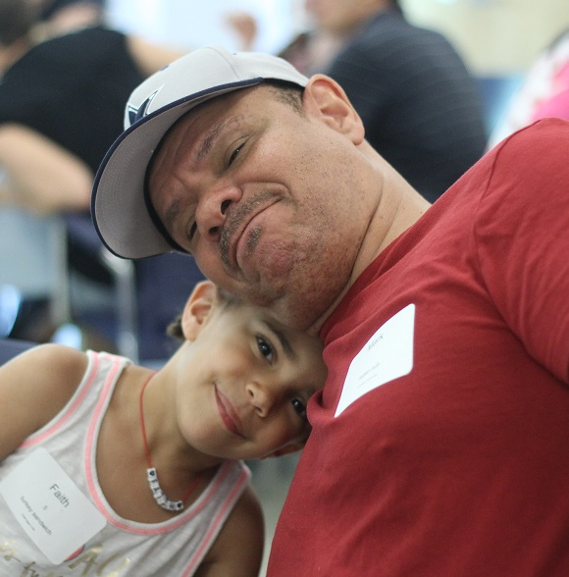
Children & youth in foster, adoptive, kinship care
A disproportionate number of children and youth have identified disabilities and are at high risk of poor academic outcomes.
Children in foster, adoptive, kinship care have disabilities and other special needs at three to four times the rate of peers in birth and step families.
ESSA has refocused attention on the long-documented underachievement of students in foster care. Each SEA and LEA must calculate and report assessment proficiency, disaggregated status as a child in foster care.
Notes:
…many do not, and have organic and acquired conditions that may require special education and related services. Research supports a disability prevalence rate of 3 to 4 times that of birth families,. Outcomes are pretty poor for children and youth with special needs raised in formed families. This challenge has been recently acknowledged as ESSA now includes children in foster care status as a subgroup for disaggregated reporting.
Source: https://www2.ed.gov/policy/elsec/leg/essa/essastatereportcard.pdf

Slide 28
Endrew F.: What families are focused on…
To meet it obligations under IDEA, schools must offer an IEP “reasonably calculated to enable a child to make progress in light of the child’s circumstances.”
All children should have the opportunity to meet “challenging objectives.”
The new standard requires a “prospective judgement by school officials” that “will be informed not only by the expertise of school officials, but also by the input of the child’s parents and guardians.”
The Court articulated a shift to higher expectations. To make this happen “advocacy begins and ends with the families directly impacted and the family organizations that educate and support them.” (Autin, Docherty & Agoratus, 2018)
“reasonably calculated…” is a “markedly more demanding” standard than the merely more than de minimis test (cited by US District Judge L. Babcock, District Court of Colorado, Feb 2018 ruling)
Notes:
The impact of serious, traumatizing experiences on behavioral, social emotional, and academic readiness has contributed to historical underachievement of many children and youth in care. So for foster, adoptive and kinship families, the Endrew F decision offers welcome clarification regarding FAPE. It offers a strong foundation on which all families can fulfill their advocacy and involvement responsibilities. Diana Autin of NJ- SPAN and others have done some great work on helping families understand the implications of the ruling. In particular, these clarifications remind those of raising and working with children who experience the greatest barriers to achievement, including those who are disproportionately represented in special education and for whom expectations are often set sadly low, of the power of potential in every child and youth. This is a critical shift in policy and practice to a presumption of progress toward challenging objectives, guided by an individual child’s specific circumstances, no matter the ‘tough places’ in their past or present. It serves families, schools and broader community well in the immediate and for years to come.
Background Notes: A focus on making decisions informed by school personnel’s “expertise, the progress of the child, potential for growth, and the views of the parents” (check for quote in Endrew)
From Endrew decision, pg 15 The “reasonably calculated” qualification reflects a recognition that crafting an appropriate program of education requires a prospective judgment by school officials. Id., at 207. The Act contemplates that this fact-intensive exercise will be informed not only by the expertise of school officials, but also by the input of the child’s parents or guardians. Id., at 208–209.

Slide 29
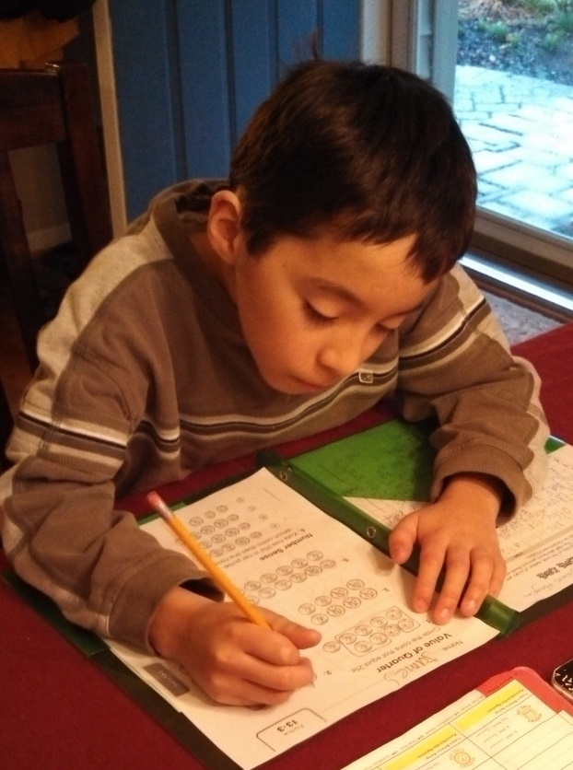
Importance of I in IEPs
Individualized- looking at that one child or youth, where has he or she been? What are the child’s strengths? The child’s needs? How effective have instructional strategies, supports and services been? Informed by:
  Past and present performance (PLOP, PLEP)
  Rate of academic growth
  If the child is on track for meeting or exceeding grade-level proficiency
  Any behaviors interfering with progress
  Additional information provided by child’s parents/caregivers.
Across domains – academic, behavioral, social-emotional, functional
IEP “procedures emphasize collaboration among parents and educators and require careful consideration of the child’s individual circumstances.” (Endrew F. decision)
Notes:
So how to operationalize the FAPE demanded by Endrew? Families know their children best, can identify critical strengths and challenges and offer insight into The job and the privilege of the IEP team is to really focus in on the needs of that one kiddo. And informed by data from past performance, valid evaluation and other assessment data, and parent/caregiver engagement, the team can craft a challenging, individualized plan that sets the stage for meaningful progress. As the Endrew decision directly states, IEP procedures emphasize collaboration between family and educators and require consideration of INDIVIDUAL circumstances.
Source: Some factors suggested by Autin et al., 2018
From Endrew decision: The IEP is “the centerpiece of the statute’s education delivery system for disabled children.” Honig v. Doe, 484 U. S. 305, 311 (1988). A comprehensive plan prepared by a child’s “IEP Team” (which includes teachers, school officials, and the child’s parents), an IEP must be drafted in compliance with a detailed set of procedures. These procedures emphasize collaboration among parents and educators and require careful consideration of the child’s individual circumstances.

Slide 30

What do high expectations look like for families?
An individualized program that actually assumes growth of the child. Program (statement of special education and related services, and program modifications or supports for school personnel, in specified settings) that actually stems from the goals/objectives.
New goals! Same goals are not reused year to year.
Goals that include all components. Criteria that include denominators! At least quarterly progress markers.
SMART goals: specific, measurable, use action words, are realistic and relevant, and time-limited.
Informed students and families INFORM the team decision making.
IEP meetings that are about more about content than process- what is our commitment to this child, teachers, staff and family to meet the goals?
Notes:
In practice, families want to see some pretty fundamental features honored in IEP planning and implementation. We often talk with families about the concept of the P in IEP, a “program” of services and supports, in least restrictive settings. This goal-driven “program” should assume and account for growth. Goals are central, so the team should dedicate careful consideration to crafting original and complete goals, informed by the family and student directly, whenever possible. Finally, Endrew reminds us that IEPs and the meetings to develop and review a child’s individualized PROGRAM is about content first. It is an at least annual occasion to define and renew our collective commitment to the child, his or her teachers and staff, and family to meet challenging and individualized goals.

Slide 31
Challenging Objectives

Slide 32
Sarah Vazquez Video

Slide 33
High Expectations and Appropriate Supports: The Importance of IEPs
Challenging Goals & Objectives
Christopher J. Lemons, Ph.D.
Peabody College of Vanderbilt University
chris.lemons@Vanderbilt.edu
OSEP Symposium | April 9, 2018

Slide 34
Overview
What are the implications of Endrew F. on establishing challenging goals and objectives in IEPs?
What is the relation between challenging goals and objectives and state academic achievement standards?
How can IEP teams ensure that goals and objectives are aligned with Endrew F.?

Slide 35
What are the implications of Endrew F. on establishing challenging goals and objectives in IEPs?

Slide 36
Slide 4
Justices were wary of ‘de minimus’ or ‘trivial educational benefit’ standards as being appropriate for evaluating FAPE. (Yell & Bateman, 2017)
“When all is said and done, a student offered an educational program providing ‘merely more than de minimus’ progress from year to year can hardly be said to have been offered an education at all. For children with disabilities, receiving instruction that aims so low would be tantamount to ’sitting idly…awaiting the time they were old enough to drop out.’ The IDEA demands more. (Endrew, p. 14; Yell & Bateman, 2017)
Instead, schools will now be expected to offer ‘a cogent and responsive explanation’ for the IEP and demonstrate that it is ‘reasonably calculated to enable the child to make progress in light of his circumstances.’ (Endrew, p.16; Yell & Bateman, 2017)

Slide 37
Slide 5
Goals and objectives must be appropriately ambitious, reasonably calculated, and challenging.
To evaluate whether goals and objectives meet these criteria:
  Should be based on assessment data.
  Be measurable and able to monitor progress on them.
  Determined for individual children by all members of the IEP team based on the individual child’s circumstances.
Non-examples:
  The same IEP goals across multiple years with minimal progress.
  Computerized goals that are highly similar across many students.
  Easy to achieve.
It seems to me that an IEP aligned with Endrew F. would include some goals and objectives that were not met at the annual review.
  If you are meeting 100% of goals and objectives, are you being ambitious?
  When writing goals and objectives, ask whether the team would consider it meaningful and important to the child’s future if she or he obtained or nearly obtained a majority of the goals.

Slide 38
Slide 6
For some students with disabilities who are included in general education classes, proof of an appropriate education program with appropriate progress is that the child is participating in the grade-level curriculum demonstrated through achieving passing marks and advancing grade-to-grade. (Turnbull et al., 2018)
However, the Court reiterated that just meeting this standard (passing) was not necessarily an indication of FAPE.
“If that (passing) is not a reasonable prospect for a child, his IEP need not aim for grade level placement. But his educational program must be appropriately ambitious in light of his circumstances, just as advancement from grade to grade is appropriately ambitious for most children in the regular room.” (Endrew, p. 14; Turnbull et al., 2018)
Raises the bar in terms of expectations for children with disabilities whose goals are not on grade-level.

Slide 39
What is the relation between challenging goals and objectives and state academic achievement standards?

Slide 40
Slide 8
Standards are written to outline a developmental trajectory through a content area.
Each could be an appropriate IEP goal/objective target for a student with a disability at this instructional level.
Can be useful to guide an evaluation of students’ present levels of academic performance.
See the example state standards.
(K) Phonics and Word Recognition:
  ELA-LITERACY.RF.K.3
  Know and apply grade-level phonics and word analysis skills in decoding words.
    ELA-LITERACY.RF.K.3.B
    Associate the long and short sounds with the common spellings (graphemes) for the five major vowels.
(1st) Phonological Awareness:
  ELA-LITERACY.RF.1.2
  Demonstrate understanding of spoken words, syllables, and sounds (phonemes).
  ELA-LITERACY.RF.1.2.D
  Segment spoken single-syllable words into their complete sequence of individual sounds (phonemes).

Slide 41
Slide 9
  ELA-LITERACY.RF.1.2.D
  Segment spoken single-syllable words into their complete sequence of individual sounds (phonemes).
Chadwick provides only initial sounds (e.g., /m/ for ‘moon’).
Provides instructional guidance as well.
Assess student using a 1st grade curriculum-based measure (CBM) of phoneme segmentation fluency.
On median of 3 probes, Chadwick was able to provide 12 correctly segmented phonemes within 1 minute.
By the end of the school year, when presented with 3 probes from a 1st grade phoneme segmentation fluency CBM, Chadwick will correctly provide 45 correctly segmented phonemes in 1 minute on the median probe.
Yell & Stecker, 2003

Slide 42
Slide 10
However, IEP teams should not feel the need to solely rely on standards to write goals and objectives.
The IEP team should return to the language of Endrew F. to evaluate goals and objectives:
  Schools will now be expected to offer ‘a cogent and responsive explanation’ for the IEP and demonstrate that it is ‘reasonably calculated to enable the child to make progress in light of his circumstances.’ (Endrew, p.16; Yell & Bateman, 2017)

Slide 43
Slide 11
Why is considering instructional-level goals and objectives important?
A recent meta-analysis focused on reading outcomes that included 23 studies, demonstrated that students with disabilities performed, on average, 1.17 SD less well than peers w/o disabilities. (Gilmour, Fuchs, & Wehby, under review)
This represents a gap of about 3.3 years.
Thus, writing an annual goal that represents >3 years of growth may not be defensible or achievable.
Further, writing goals that are more closely aligned to the child’s current achievement level will often provide clearer guidance as to what instruction should look like.
Gilmour, A.F., Fuchs, D., & Wehby, J.H. (under review). On the gap in reading achievement between students with disabilities and their peers: Have accountability policies in special education failed?

Slide 44



Slide 12
Analogy – What is ambitious but reasonable for you? 5k? 13.1? 26.2? 3,100?
It depends on your individual circumstances. The same applies to IEP goals and objectives.

Slide 45
How can IEP teams ensure that goals and objectives are aligned with Endrew F.?

Slide 46
Slide 14
Justice Roberts referred to the IEP as a “fact-intensive exercise” (Endrew, p. 11) in which school personnel and a student’s parents collaborate to develop and implement a special education program for “pursuing academic achievement and functional advancement” (p. 11).
The focus of the IEP is on the unique needs of an individual student and is developed only after careful considerations of the student’s present levels of academic and functional performance, his or her disability, and the student’s “potential for growth” (p. 12). (Yell and Bateman, 2017, p. 12)
Instructional changes must be made when data indicate a lack of progress toward goals and objectives. (Yell and Bateman, 2017)

Slide 47
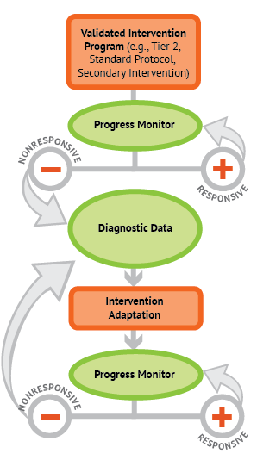
Slide 15
Data-based individualization or DBI is a research-based process for individualizing and intensifying interventions through the systematic use of assessment data, validated interventions, and research-based adaptation strategies.
Data are collected in a systematic process. Adaptations are implemented if insufficient response is demonstrated.
Ensuring that this process is followed as an IEP is implemented would provide support for decisions that IEP teams make and it would allow for collection of data to document student response.
(NCII, n.d.)

Slide 48
Resources to Learn More About DBI from 3 OSEP-Supported Centers
National Center on Intensive Intervention (NCII)
  https://intensiveintervention.org
The IRIS Center – 2 modules on DBI
  https://iris.peabody.vanderbilt.edu/module/dbi1/
  https://iris.peabody.vanderbilt.edu/module/dbi2/
National Center for Leadership in Intensive Intervention (NCLII)
  http://nclii.org

Slide 49
References
Gilmour, A.F., Fuchs, D., & Wehby, J.H. (under review). On the gap in reading achievement between students with disabilities and their peers: Have accountability policies in special education failed?
Turnbull, H.R., Turnbull, A.P., & Cooper, D.H. (2018). The Supreme Court, Endrew, and the appropriate education of students with disabilities. Exceptional Children, 84(2), 124-140.
Yell, M.L., & Bateman, D.F. (2017). Endrew F. v. Douglas County School District (2017): FAPE and the U.S. Supreme Court. Teaching Exceptional Children, (50)1, 7-15.
Yell, M.L., & Stecker, P.M. (2003). Developing legally correct and educationally meaningful IEPs using curriculum-based measurement. Assessment for Effective Intervention, (28)3-4, 73-88.

Slide 50
Incorporating Evidence-Based Practices into the IEP

Slide 51

Incorporating Evidence-based Practices in the IEP
April 9th, 2018
Sarah Sayko, Deputy Director

Slide 52
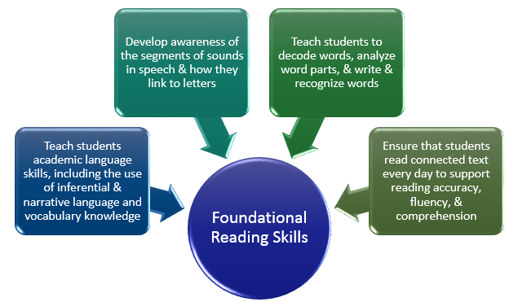
What Skills Should Be Taught (K-3)?
Foorman et al., 2016
Notes:
Students with reading disabilities require effective and adequate reading instruction in foundational reading skills. This includes teaching students academic language skills, including the use of inferential and narrative language, and vocabulary knowledge. Teachers should engage students in conversations that support the use and comprehension of inferential language; explicitly engage students in developing narrative language skills; and teach academic vocabulary in the context of other reading activities.
A critical skill to develop is students’ awareness of the segments of sounds in speech and how they link to letters. Teachers should teach students to recognize and manipulate segments of sound in speech; teach students letter-sound relations; and use word-building and other activities to link students’ knowledge of letter-sound relationships with phonemic awareness.
A second critical skill is to teach students to decode words, analyze word parts, and write and recognize words. This includes teaching students to blend letter sounds and sound-spelling patterns from left to right within a word to produce a recognizable pronunciation; instructing students in common sound-spelling patterns; teaching students to recognize common word parts; having students read decodable words in isolation and in text; teaching regular and irregular high-frequency words so that students can recognize them efficiently; and introducing non-decodable words that are essential to the meaning of the text as whole words.
Finally, teachers should ensure that each student reads connected text every day to support reading accuracy, fluency, and comprehension. As students read orally, teachers should model strategies, scaffold, and provide feedback to support accurate and efficient word identification; teach students to self-monitor their understanding of the text and to self correct word-reading errors; and provide opportunities for oral reading practice with feedback to develop fluent and accurate reading with expression.
When response to instruction is inadequate, interventions need to be employed that target the specific types of skills and knowledge that are interfering with students reading growth and have evidence of effectiveness for improving these skills and knowledge.

Slide 53
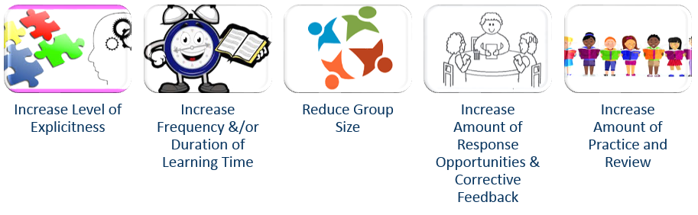
Methods for intensifying interventions
Harlacher, Nelson-Walker, & Sanford, 2010;
Vaughn, Wanzek, Murray, & Roberts, 2012
Notes:
Not only do children with or at risk for reading disabilities require more explicit instruction they also acquire skills and knowledge in the phonological domain more slowly than typical readers. That is why these children need much more intensive instruction than other students to order to maintain typical growth patterns in reading. In other words, the lesson is clearly presented and the skills modeled and demonstrated step by step. Explicit instruction also includes more modeling and more detailed explanations when needed. Complex skills may need to be broken down into smaller, manageable chunks of learning and carefully sequenced from easier to more difficult. Tasks might need to broken down into smaller steps too.
Second, interventions should increase learning time. This includes the frequency of intervention, length of the instructional sessions, and duration of the intervention. Movement decisions should be made based on how far the student’s achievement level is below grade-level expectations, the length and frequency of the previous interventions, and the complexity of the learning tasks at hand. Student- and school-level factors must also be considered.
Third, interventions should reduce the instructional group size. Research suggests that small groups of 2-4 students or one-on-one instruction may provide the most intensive intervention. When group size is decreased, teacher attention can be divided among fewer students and increase the potential for individualized instruction, more student response and practice, and teacher feedback.
Fourth, interventions should provide frequent opportunities for student practice, response, and feedback. Feedback from teachers should be specific and descriptive and teachers should monitor student understanding. The intervention should provide more concrete student learning opportunities through the use of pictures, graphics, manipulatives, or think alouds.
Finally, independent practice is an essential part of intervention but is not a substitute for explicit instruction and guided practice. Teachers should incorporate independent work after students begin to demonstrate mastery of new skills and integrate judicious review of previously learned skills.

Slide 54
What do strong iep literacy goals look like?
PRESENT LEVEL OF PERFORMANCE | ANNUAL GOAL AND OBJECTIVES
Reads first-grade material at 20-30 words per minute with 5-10 errors; guesses at unknown words | Goal: Will read third-grade material at 80-100 words per minute with 0-2 errors. Objective 1: By December 15th will read second-grade material at 40-60 wpm with 0-5 errors.
Spells words dictated from third-grade list with 50% accuracy. | Goal: Spells words dictated from third-grade list with 90% accuracy. Objective 1: By December 1st spells words dictated from third-grade list with 75% accuracy.
Hall & Moats, 2002
Notes:
Strong literacy goals in IEPs should be specific, quantifiable, and measurable to ensure progress/growth in literacy skills can be determined. For each goal that is identified for the IEP, the staff need to provide data in order to establish a baseline for the specific objectives identified to reach each goal. They also should focus on strategies implemented over the course of one entire school year and be data-driven, using test scores, observation, and/or concrete examples.

Slide 55

Ensuring Effective Specially Designed Instruction
Iowa’s Experiences Implementing the SSIP and SPDG
April 9, 2018
Barbara Guy

Slide 56
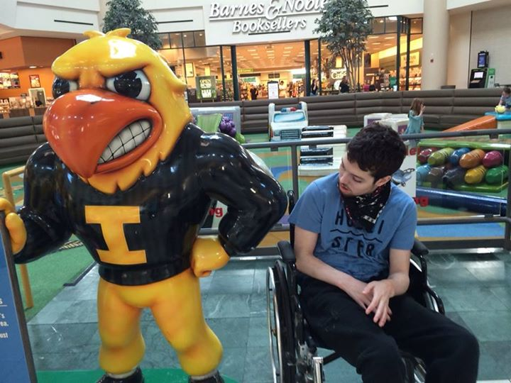



Slide 2
Individualization
Instruction

Slide 57
In the next 10 minutes
Background on Iowa’s journey
Overview of our SSIP/SPDG work
Lessons We’re Learning

Slide 58
Background on Iowa’s Journey
Began in July, 2013 with a desire to measure the effectiveness of SDI
Two years of stakeholder engagement to develop Iowa’s Framework for Specially Designed Instruction (SDI)
2015 - became the focus of Iowa’s SPDG and SSIP
Currently in the third year of development/implementation

Slide 59
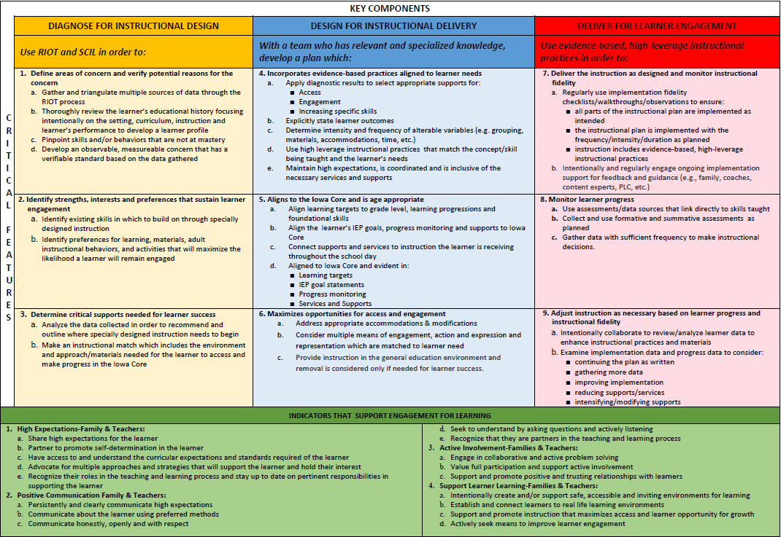
Iowa’s Framework for Specially Designed Instruction

Slide 60
Engage for Learning (Family-School Partnerships)
High Expectations
Positive Communication
Active Involvement
Support Student Learning

Slide 61
Current Work- Focus on Literacy (3rd grade proficiency)
3 Areas of Focus- Preschool, Significant Disabilities, K-6 (attempts to embed AEM)
Currently have 102 Usability Sites and 6 Cohort Sites.
Structures we’re building include Design Teams, Delivery and Support Team and a Coaching Network

Slide 62
Lessons Learned
Alignment is messy and very difficult.
A plan is good but adaptation is essential.
Effective Specially Designed Instruction cannot be measured with a single method, unit, variable or indicator.

Slide 63

Alignment is Messy and Very Difficult
Content Rich
Meaning of “Access”
Cumbersome “successful strategies”

Slide 64
A Plan is Good but Adaptation is Essential.
Everything takes longer
  Development
  Learning
  Capacity building
Unit of Change
Scale-up

Slide 65

Effective Specially Designed Instruction can not be measured with a single method, unit, variable or indicator.

Slide 66


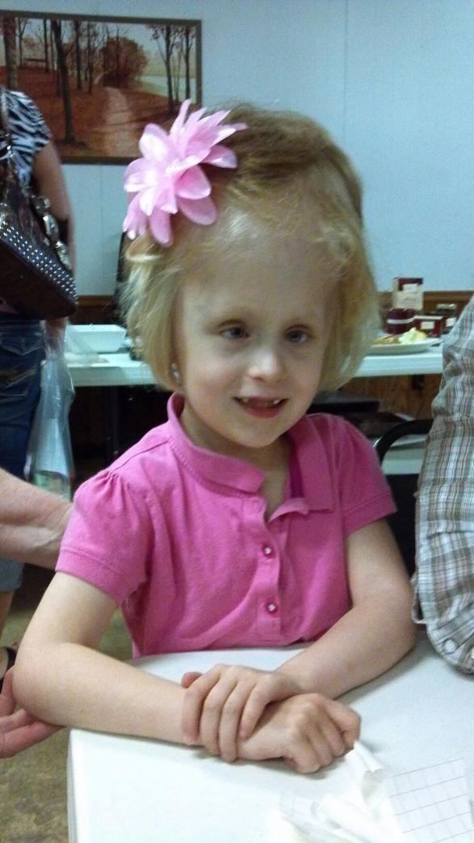
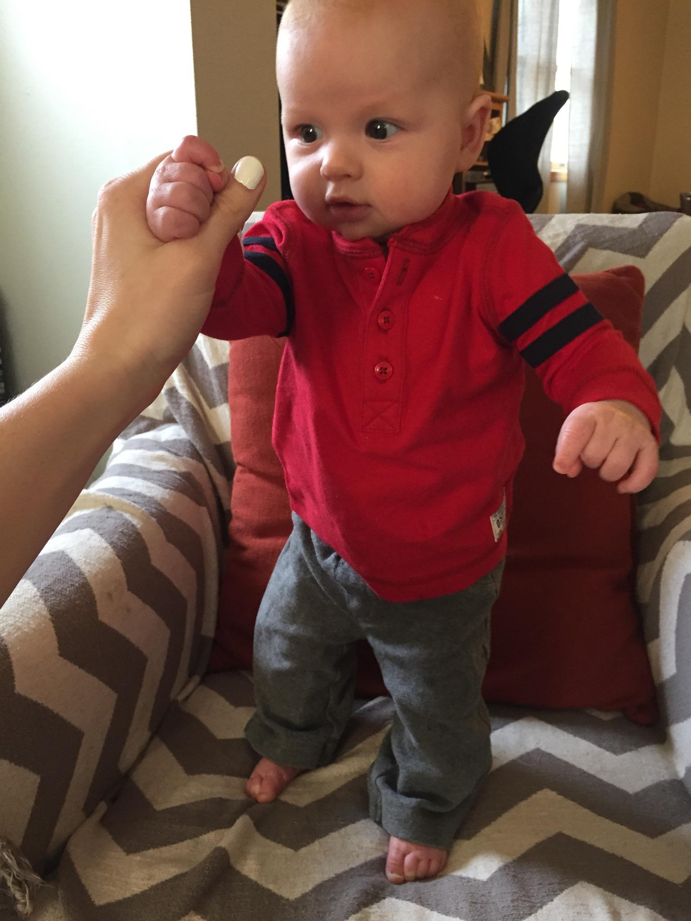
Slide 12
The promise of specially designed instruction cannot be fulfilled unless we have a shared belief of expectation, purpose and responsibility.

Slide 67
Families as Co-creators

Slide 68
From Start to Finish
Families as Co-Creators of IEPs
Rosa Milagros Santos, PhD
Department of Special Education
University of Illinois at Urbana-Champaign
rsantos@illinois.edu

Slide 69

Learn about how education agencies, families, and other stakeholders can work together to develop and implement high-quality IEPs.
Why we collaborate with families
What we know from research
What it looks like in practice

Slide 70

In what ways are families involved in or engaged with your program?
Share your response in the chat pod

Slide 71
Endrew F. v. Douglas County School District Re-1, 137 S. Ct. 988
…a school must offer an IEP that is “reasonably calculated to enable a child to make progress appropriate in light of the child’s circumstances.”
…school personnel will make decisions that are informed by their own expertise, the progress of the child, the child’s potential for growth, and the views of the child’s parents.
…the IEP Team should consider the child’s previous rate of academic growth, whether the child is on track to achieve or exceed grade-level proficiency, any behaviors interfering with the child’s progress, and additional information and input provided by the child’s parents.
…the Court stated that the IEP Team, which must include the child’s parents --- as Team members, must give “careful consideration to the child’s present levels of achievement, disability, and potential for growth.”

Slide 72
Families are the constant in the lives of individuals with disabilities
WHY
“We want the very best outcomes for children not only while we are working with them… but we want positive outcomes for them in the years to come, long after we are no longer in their lives.”
Trivette & Banerjee (2015)

Slide 73
The family is a powerful partner
WHY
“Families know so much more than practitioners about their hopes and dreams for their children.”
Trivette & Keilty (2017)

Slide 74
All individuals develop and learn within the context of their families and cultures
WHY
“Children need to learn the skills and behaviors that ensure acceptance, participation, and membership in their families and communities.”
Trivette & Banerjee (2015)

Slide 75

Share other reasons WHY families should be co-creators of IEPS…
Share your ideas in the chat pod

Slide 76



What Research Tells Us
Family-centered practices
Family-capacity-building practices
Family and professional collaboration

Slide 77
What Research Tells Us
Need to change one’s perspective from thinking of oneself as the only expert at the table but rather to be a partner, consultant, and problem-solver with families.
Need to build time to the process to encourage ongoing discussions, and not overwhelm families with all of the information at one time.
Support advocacy through building connection among parents to share information.

Slide 78
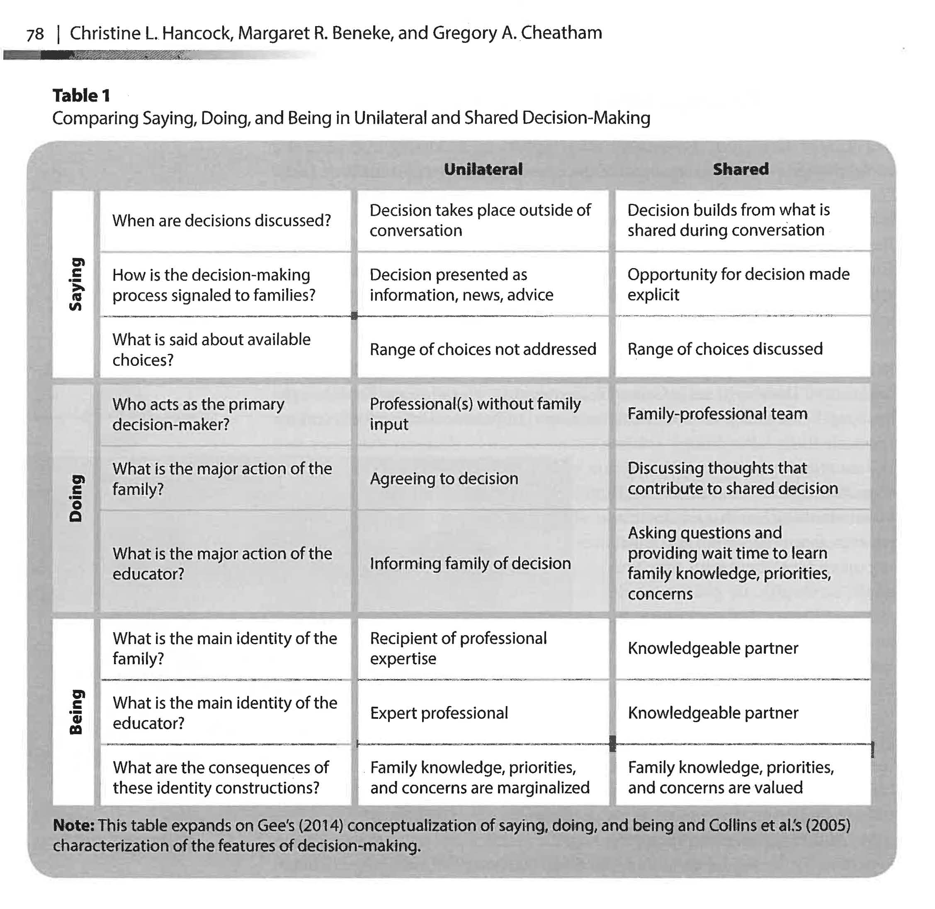
“Communication is at the heart of partnerships”
Power and inequity during IEP meetings
Pervasiveness of unilateral decision-making
Discourse involves saying, doing, and being
Hancock, Beneke, & Cheatham (2017)

Slide 79
What is your go-to strategy to engage families in co-creating IEPS?
Share your strategy in the chat pod

Slide 80

Families are their children’s first and most important teachers, advocates, and nurturers. As such, strong family engagement is central–not supplemental–to their success… (we all) have the responsibility to promote and implement effective family engagement to improve children’s learning, development, and wellness.

Slide 81

Families must come away from every interaction with practitioners believing more in themselves than when we started.
Trivette & Keilty (2017)

Slide 82
RESOURCES
Division for Early Childhood of the Council for Exceptional Children’s Recommended Practices (2014). http://www.dec-sped.org/dec-recommended-practices
Division for Early Childhood. (2015). DEC recommended practices: Enhancing services for young children with disabilities and their families (DEC Recommended Practices Monograph Series No. 1). Los Angeles, CA: Author. http://www.dec-sped.org/product-page/dec-recommended-practices-enhancing-services-for-young-children
Questions and Answers (Q&A) on U. S. Supreme Court Case Decision Endrew F. v. Douglas County School District Re-1(December 7, 2017) https://sites.ed.gov/idea/files/qa-endrewcase-12-07-2017.pdf
Trivette, C. M. & Keilty, B. (Eds.). (2017). Family: Knowing families, tailoring practices, building capacity (DEC Recommended Practices Monograph Series No. 3). Washington, DC: Division for Early Childhood. https://bookstore.dec-sped.org/product-p/decrp3.htm
U.S. Department Of Health And Human Services U.S. Department Of Education Policy Statement On Family Engagement From The Early Years To The Early Grades (May 5, 2016) https://www2.ed.gov/about/inits/ed/earlylearning/files/policy-statement-on-family-engagement.pdf

Slide 83
Lessons Learned from a General Education Teacher
(and Special Education Parent)

Slide 84
Background
General education teacher for 16 years
Limited experience with students with disabilities
Struggled as a parent of twins with IEPs

Slide 85
Takeaways
Lack of preparation
Outdated systems and structures
Culture and climate issues

Slide 86
Challenges
General education and special education silos
Funding is separate, training is separate, curriculum and resources are separate
Too often, instruction is separate

Slide 87
Possibilities
Rethinking personnel preparation
Special education training for ALL educators so we can have high expectations for ALL students
More inclusive practices
Greater awareness and use of resources

Slide 88
Questions & Answers

Slide 89
Slide 89

